Slide 1
Whose Job Is It Anyway?
Supporting transitions for young people with life limiting conditions
Claire Turnbull & Janette McGarvey
June 2016

Slide 2
Who do we support?
Young people with LLC over 18
Young people with life threatening condition
Prevalence?
Notes:
(Claire)
CHAS is Scotland’s only provider of hospice care for B,Ch and YP, and families.
TT supports young people over 18 yrs who are moving on from CHAS to age appropriate provision (CHAS upper age limit now 21)
All our Life limiting / shortening / threatening conditions – all terms used
ChiSP – stats etc – categorises into stages (dying/deteriorating/stable/?)

Slide 3
Transitions
The word 'transition' simply means moving to another time in your life
Transition is often used to describe the planning process that happens when someone with additional support needs becomes a young adult and is leaving school
Not everyone likes change!
A successful transition must include planning which keeps young people at the centre, and involves a coordinated approach (Principles of Good Transition 2, 2014)
Notes:
(Claire)

Slide 4
Group exercise Palliative Care
Small groups of 3-4
Consider what your understanding of palliative care is
Come up with a definition of palliative care to present back to the group
Notes:
(5-10 mins)

Slide 5
What is palliative care?
“Palliative care is an approach that improves the quality of life of patients and their families facing the problem associated with life-threatening illness, through the prevention and relief of suffering by means of early identification and impeccable assessment and treatment of pain and other problems, physical, psychosocial and spiritual.”
(World Health Organisation)
Notes:
(Claire)
Palliative care principles:-
a focus on quality of life which includes good symptom control
a whole person approach which takes into account the person's past life experience and current situation
care which encompasses both the person with the life-threatening illness and those that matter to that person
respect for patient autonomy and choice
emphasis on open and sensitive communication
Consider then who is responsible for provision of ‘palliative care’ in Scotland?
What is the role of education/learning providers and third sector organisations in supporting people with a palliative need?

Slide 6
Who are we?
Transition Team includes Team Manager, Transition Workers, Administrative Assistant
Funding secured from BIG Lottery
Team started Dec 2014
Currently supporting 57 young people and their families
17 young people have made the transition from CHAS
In total, the 3 year project will support around 85 YP and their families
Work within specific framework around 3 key outcomes
Based in Rachel and Robin House hospices, we cover the whole of Scotland
Notes:
(Claire)

Slide 7
What Frames Our Work
The law
Self Directed Support
Disability Discrimination Act 1995
Equality Strategy
Education Act (Additional Support for Learning) 2004
Carers Act (Scotland) 2016
Adult Support and Protection Act (2007)
Adults with Incapacity Act (AWIA) (2000)
Policy agenda
Health and Social Care Integration
Living and Dying Well (2008)
Strategic Framework for Action on Palliative & End of life care (2016)
Gold Standard Framework/Scottish Palliative Care Guidelines
Personalisation
Regulation of Care/national standards

Slide 8
Principles of our support
Engagement with our team is voluntary
We work at a pace which suits the young person and their family
We support people to be as independent as possible, to make the most of their life, and set goals
Transition plans are individual and focus on whatever that young person feels is important
With their permission, we work in partnership with colleagues in health, social work and the third sector … having a budget is key to funding alternative respite and increased supports
We have those ‘difficult conversations’, and engage in dialogue with young people and families about their end of life care and how they want this to look
We support families and work closely with parents and siblings
Once alternative supports are in place and the young person is confident about moving away from CHAS, we will then agree plans for their final transition
Notes:
(Janette)
Keeping babies, children, young people, and their families at the heart of what we do underpins all the work we do at CHAS – the work of the TT echoes this value and we support people in a person centred way to move on from CHAS to more age appropriate services and care.
Aspirational – we support young people to get the life they want, and to celebrate life – begins at 18 (sometimes earlier if appt)
Lot of our work involves liaising with colleagues in health/social care and the third sector (inc partners in adult hospice care) – preparation for them engaging with young adults with LLCs in the community, upskilling of staff
Three main areas of our work thus far –
respite – finding alternative short break provision
ensuring end of life plans/ACPs are in place, that each YP and family have a plan should their situation deteriorate
supporting siblings/families/carers
NB – we are mindful of health deterioration and sudden changes in a YP situation

Slide 9
What do we do?
Our work is person-centred, working with each individual to develop their unique transition plan which may include -
help to find alternative respite, short breaks and holidays (trial breaks!)
advocacy
engaging with local authorities to secure or increase funding
supporting young people and carers with specific health needs
finding leisure & learning activities in person’s community
helping young people build social networks & find new relationships
direct support for parents and siblings
advice re benefits
working with adult hospices
end of life care planning - inc links with adult hospices, providing information, completing plans
applying for grants for specialised equipment or opportunities
referrals to other agencies(eg vocational training schemes, education provisions, specialist nursing)
signposting - source & provide information!
linking with strategic partners (third sector, NHS, social work, Scottish Govt) to support future service development and work together to create appropriate services to meet need
Notes:
(Janette)

Slide 10
Living with a Life Limiting Condition - Young People’s experience
Notes:
DVD

Slide 11
Group exercise – Inclusion in learning
In groups of 6-8
Inclusion – the equality act requires learning providers to offer an inclusive integrated approach, and to make adjustments
Come up with 3 examples of how your workplace rises to this challenge?
Feedback to the group
Notes:
(10minutes)
How does each workplace do this?
Is it working?
How are you being creative and innovative to achieve this?
Consider how well people are then prepared for the world of work?
(RECAP – summarise, use flipcharts, share)

Slide 12
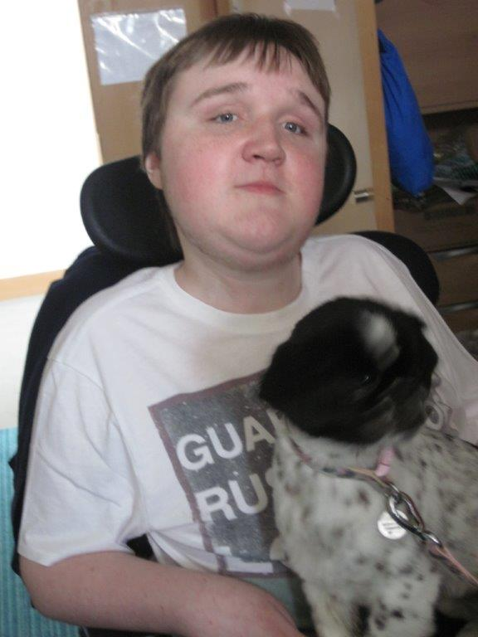
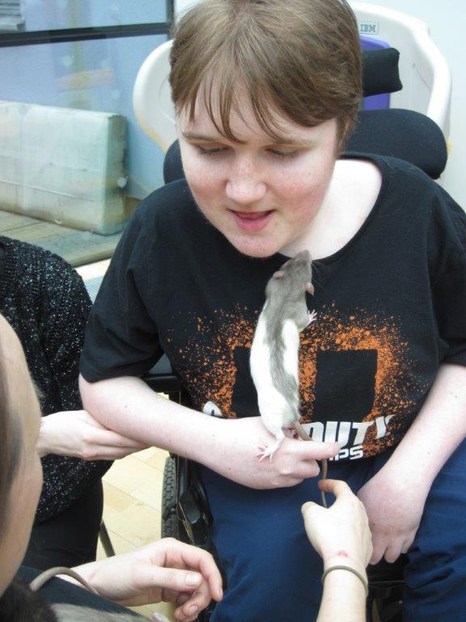
Scott’s Story

Slide 13
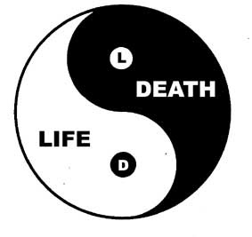
Unique needs? Or simply a need for better inclusion?
What are we finding out so far?
What are the unique needs of people with LLCs?
Notes:
(Claire & Janette)
Unique needs –
Precarious health & fluctuations means learning needs to be flexible (as attendance and engagement can vary)
Bereavement and loss – as well as having to face their own mortality, yp with LLC often have peers with similar conditions and many lose friends at an early age. Consider the impact on emotional health and wellbeing, and therefore their learning
Physical needs and complex health – barriers and physical restrictions, impact on learning
Social isolation and experience – they may be socially isolated and struggle with able bodied peers, esp given presence of a PA

Slide 14
Our experience
Are there common themes emerging?
Notes:
(Claire & Janette)
Common themes in learning and education experiences -
Physical barriers and restrictions on campus (accessing toilet facs for eg, being able to eat via gastrostomy private space)
Lack of appropriate courses
Study and home work – use of online support for people when studying at home in evenings – variation between learning places
Use of technology and creative solutions to enable and include learners
Communication (positive and negative)
Physical accessibility (eg large electric wheelchairs)

Slide 15
Working Lives & Opportunities
Seeming lack of opportunities for work placements / vocational training
And for ‘real’ jobs

Slide 16
Any questions?

Slide 17
Contact Us
Claire Turnbull Janette McGarvey
Transition Team Manager Transition Worker
Rachel House Robin House
Avenue Road
KINROSS BALLOCH
KY13 8FX
Tel 01577 865777 Tel 01389 722055
claireturnbull@chas.org.uk janettemcgarve@chas.org.uk

