Slide 1
A Right to Learn Improving access to services which support transitions
Rebecca Curran-Scarlett
Alyson Woodhouse
Ashleigh Milroy
Neil Skene
Alan Parker

Slide 2
“So, where can my child go after they leave school…?”

Slide 3
“The gap in post-school provision for young people with multiple and profound disabilities, is systematically applied across Scotland: that is direct discrimination on the basis of disability and is unacceptable when my child’s peers, are offered access to free education post school;
the suggestion that my child has to self-fund their Further Education provision, due to their disability, whilst their peers access free FE provision in Scotland is deeply disconcerting and a totally unreasonable position for them to be put in.”

Slide 4
A Guide to Community Based Adult Learning
Find our guide on our website: https://www.lead.org.uk/a-guide-to-community-based-adult-learning/
The guide is available in 11 different formats and languages
It was co-produced by a group of six paid disabled participants
Topics include what is CBAL, where to access it, using CBAL to influence change, CBAL for mental health, your rights as a disabled learner

Slide 5
What is community based adult learning?
CBAL is both a course of learning and an approach to learning.
Classes should be learner centred with a lifelong and life wide reach.
They can be formal or informal and are not limited to take place in specific venues.
Venues include community venues, online, at home, in workplaces and in colleges and universities.

Slide 6
Who is community based adult learning for?
Young adults Ex-prisoners Retired people Families
Disabled adults Workers Trade unionists
Refugees Prisoners Women Unemployed People

Slide 7
What can you learn on a CBAL course?
Coping with anxiety Bicycle maintenance Baking
Painting in prison Digital skills Gardening
English as a second language Literacy and numeracy

Slide 8
Theatre Workshops

Slide 9
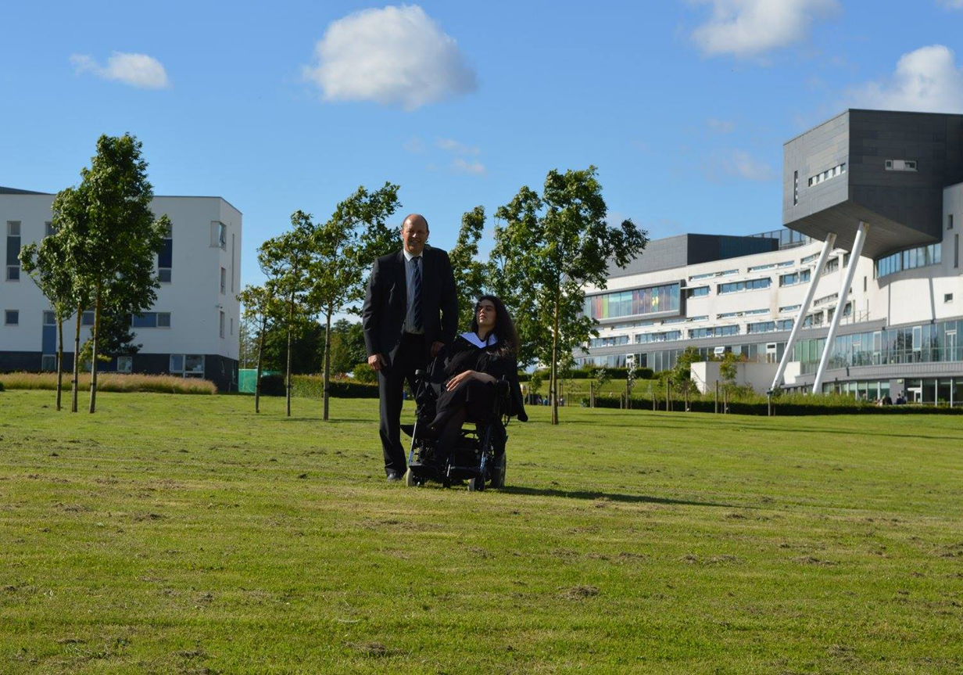
Graduating university!

Slide 10
Workshopping at Partners in Policy Making…

Slide 11
Using CBAL to influence change

Slide 12
Accessing assistive technology and reasonable adjustments
In the guide you can learn…
What is assistive technology (AT)?
Who is it for?
Where can you access training in digital skills and AT?
What are your rights as a disabled learner?
How to ask a learning provider to meet your support needs?
And lots more…!

Slide 13
My home studio!

Slide 14
Outside SHMU – Station House Media Unit

