Slide 1
Transitions – Have Your Say
Sarah Burton

Slide 2
Setting the scene
Adult Learning & CLD
Barriers
Life Challenges
Transitions

Slide 3
Life challenges
The recursive loop of impacts on learning for disabled people
Health or accessibility challenges interrupting learning
Reduced confidence to seek learning or support
Reduced ability to self manage or self advocate
Reduced engagement with vital services
Reduced engagement with learning to overcome unemployment, poverty, & social isolation barriers
Adverse impacts on physical and mental health

Slide 4
Barriers
Top 6 barriers to learning reported by disabled people and unpaid carers 2020-2025
(Lead Scotland learner registration surveys 2020 to 2025, 912 respondents from learners exiting the service)
49% Need to improve digital skills
42% Need support to get started
32% Lack in confidence about learning
26% Lack of knowledge about choices
16% Negative previous experience of learning
16% Need support with reading, writing, numbers

Slide 5
Transitions
Characteristics of effective transitions
(Drawn from Transitions to adulthood for disabled young people: literature review, Scottish Government, 27 February 2023)
Early intervention and sustained transition planning
Holistic and coordinated wrap-around support
Services delivered in partnership
Designated keyworkers for coordinating and continuity
Person-centred support and preparation
Family and/or carer involvement in planning and decision-making
Family and carer support throughout transitions
The provision of clear and accessible information
Adequate services, resources, and staffing

Slide 6
Strategic view – Adult Learning & CLD
(*Drawn from HMIE Evaluation of community learning and development in Scotland: Considering the provision by local authorities and their partners, Education Scotland, December 2024)
Adult learners in particular are under-represented in CLD planning at area and strategic level.
Due to a mix of changing resources and increased targeting of provision, the range of community-based adult learning offered has narrowed. As a result, the needs of some individuals and communities are not being met.
ZERO
The number of times the word "transitions" is referred to in the report.
ONE
The number of times the word "transition" is used in the report. (It was in a passive sense)
Notes:
“As they transition into volunteer roles and start to contribute to supporting others with their learning and towards their communities developing, many find their confidence and wellbeing improves”

Slide 7
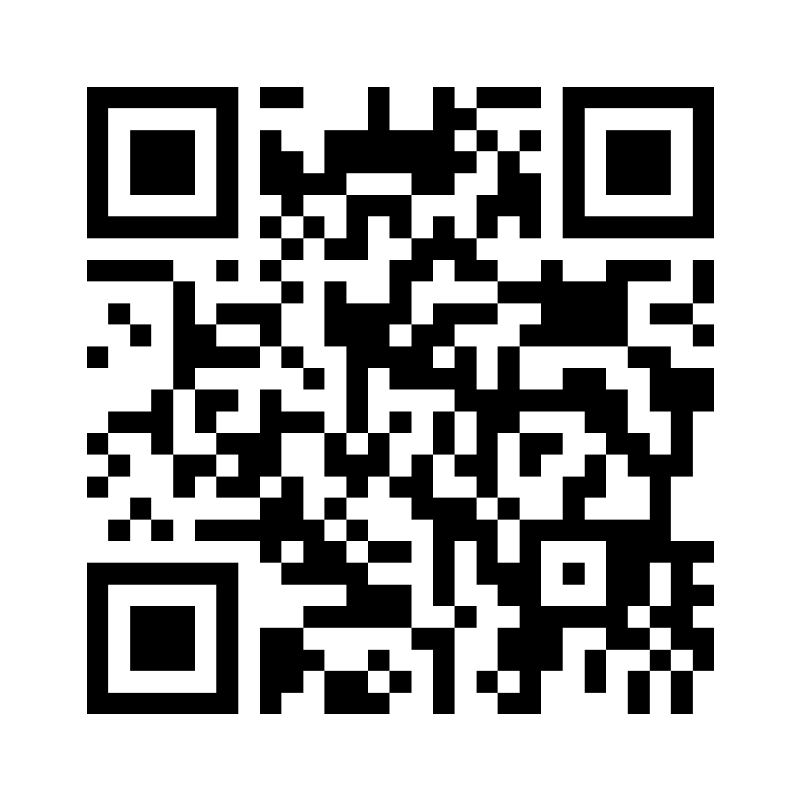
Have your say !
If you could ask your MSP for more opportunities and better transitions, what would you ask for?
Join at menti.com | use code 1999 6409
Barrier
Adult Learning & CLD
Transitions
Life Challenges

