Slide 1
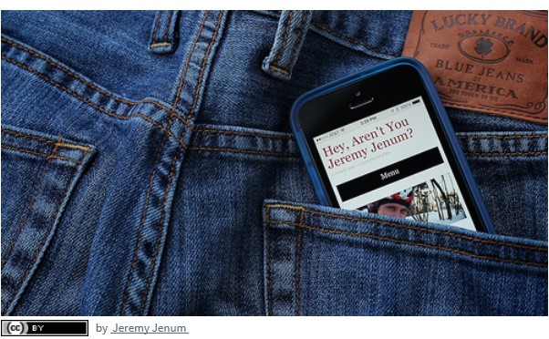
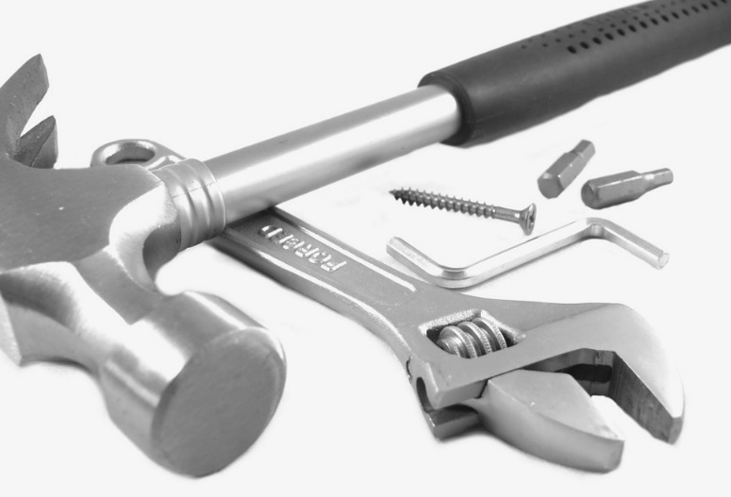

Images: Pixabay and Microsoft
Free enabling technologies:
Because little things can make a big difference
Technology as a tool for inclusion: are we there yet?
Notes:
Unpack and explore the role that technology can play as a tool for inclusion …..
The capacity that you have as enabler to share and to explore possibilities with learners
and also as an advocate or agent of change to consider how you can share information also with your colleagues

Slide 2
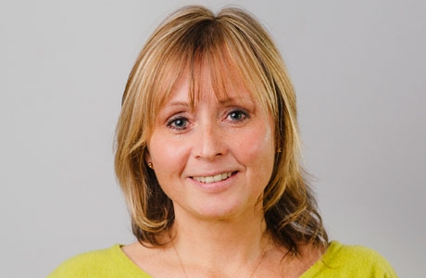
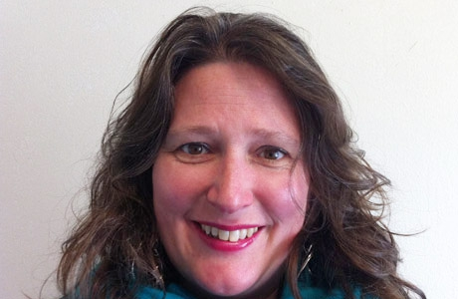
Introduction
Photograph with kind permission of Susan Wakefield Gibbons
Jisc Scotland
Margaret McKay subject specialist (accessibility & inclusion)
Irene Warner-Mackintosh, Community engagement officer
Free enabling technologies:
Because little things can make a big difference
Notes:
Margaret McKay, subject specialist for accessibility and inclusion at Jisc Scotland.
Hopefully this will be an interactive session – opportunity to engage, contribute to discussions and to share your experiences through the session.
Look at
Different kinds of emerging technology
examples of practice in FE and HE across the UK,
Think about some technology based solutions/approaches in our group work
The role that a wider range of stakeholders FE/HE can have in implementing inclusiveness,
If you have any questions please do not hesitate to put up your hand and/or add comment in the chat pane. I’ll try to remember to keep my eye on it.
Turn my video off now to prevent any bandwith issues.

Slide 3


Who we are
Jisc is the UK higher, further education
not-for-profit organisation for digital services and solutions
Provide trusted advice and practical assistance for universities and colleges
Operate shared digital infrastructure and services
We…
Negotiate sector-wide deals with IT vendors and commercial publishers
Notes:
Jisc is the UK higher, further education
not-for-profit organisation for digital services and solutions
Provide trusted advice and practical assistance for universities and colleges
Negotiate sector-wide deals with IT vendors and commercial publishers
Operate shared digital infrastructure and services

Slide 4



We do three main things
We do 3 main things
Shared digital infrastructure and services
Sector wide deals with IT vendors and commercial publishers
Expert and trusted advice and practical assistance
examples:
Janet network, eduroam wireless,
examples:
Microsoft 365 email,,
e-journals,
FE e-books
examples:
inclusion advice cloud advice,
cyber security/business continuity,
Learning, teaching and assessment

Slide 5
Jisc
Jisc Scotland…
1
3
1
3
22
1
Head of Jisc Scotland
(and Jisc Northern Ireland)
Account managers
Community engagement officer
2 people
job sharing
Dedicated Subject Specialist for Scotland
Other UK wide Subject Specialists at your disposal
Route into the rest of Jisc
Notes:
1 head of service
2 account managers
1 Community engagement office
3 dedicated subject specialists
22 other UK wide subject specialists at our disposal including
libraries and digital resources
systems, tools and information management
technology to support enterprise
technology and the law
strategy and business process
Research, scholarly communication
strategy and business process
systems tools and information management
About me and jisc..what about you?

Slide 6
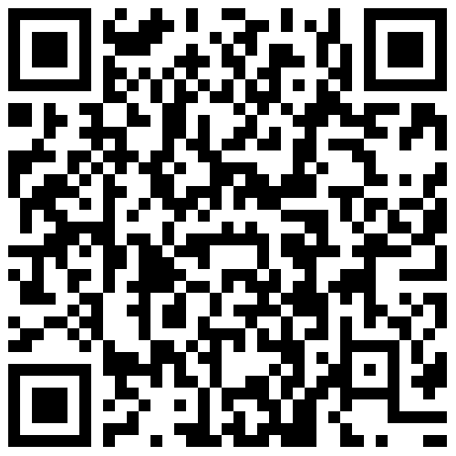
Lets get to know each other: What is your role in your place of work?
To answer this question go to
www.govote.at
and use the code
47 98 93
or scan this code below
Learning support/disability support advisor in a college or university
Careers/employment/transition advisor
Lecturer/tutor
librarian/learning resources practitioner
Support officer/personal development practitioner
other
Notes:
Learning support/disability support advisor in a college or university
Careers/employment/transition advisor
Lecturer/tutor
librarian/learning resources practitioner
Support officer/personal development practitioner
other
To answer this question go to
www.govote.at
and use the code 92 96 72

Slide 7

Main focus for our session
How can accessibility influence good practice and how can good practice improve accessibility?
Notes:
How can accessibility influence good practice and how can good practice improve accessibility?
Could something that has a legal entitlement leverage good practice?
Free/no cost approaches by learners and by practitioners

Slide 8
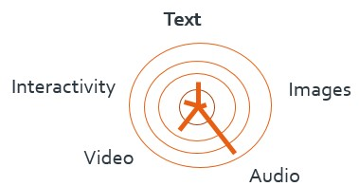
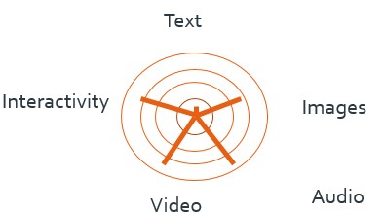
Preferred way of accessing information
Vision Loss
Dyslexia
© Alistair McNaught Jisc
Notes:
Let’s think very broadly about the potential ways that people with particular disabilities access and assimilate information.
Vision loss may favour- audio and or other multi-sensory resources to help either replace or augment text. We know that where text exists, often people choose to magnify, to listen to it or both.
People who have dyslexia – possibly find interactivity, images, audio and video more accessible - and are sometimes less comfortable with text or indeed find that multi-sensory content helps add value to text.

Slide 9
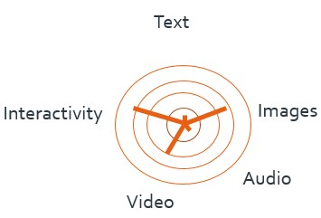
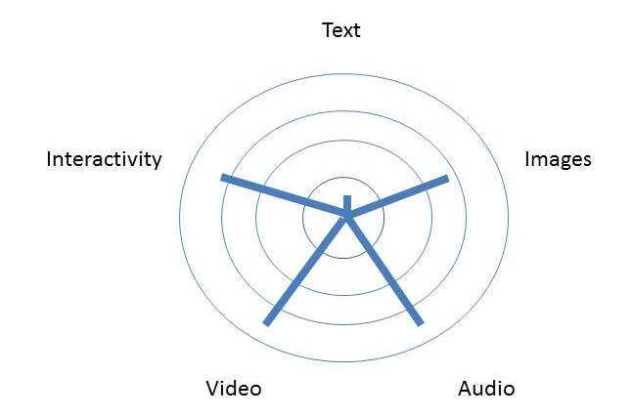
Preferred way of accessing information
Hearing Loss
Learning Difficulty
© Alistair McNaught Jisc
Notes:
Hearing Loss
People with hearing loss may struggle with audio (podcasts or video), especially when there is no additional text based information to provide further content. Equally people who are primary BSL users sometimes struggle with text, especially where English is their second language.
Learning difficulty
Similarly students with learning difficulties might engage less with text and better with more multi-sensory and creative ways of conveying information

Slide 10
All together now…
Text
Images
Interactivity
Audio
Video
© Alistair McNaught Jisc
Notes:
Pulling this together we find it is printed text is probably the least favoured way of conveying information, and although we have been talking about disability here we could say that this might be the case for a much wider representative group of learners.
Indeed there has been growing recognition that these multi-sensory approaches have a significant part to play in reducing barriers in the wider sense.
British Dyslexia Association suggests that 10% of the population have dyslexia, and if we can improve access for 10% of our learners we have the capacity to improve access for 100% - creating a fairer experience for everyone.
How can we make text more user friendly?
How can we exploit the capacity to augment or add value to text as a more traditional approach?
How can we appreciate the benefits and exploit different possibilities when information accessed in different ways using mobile technologies, where it is web based or on social media?

Slide 11
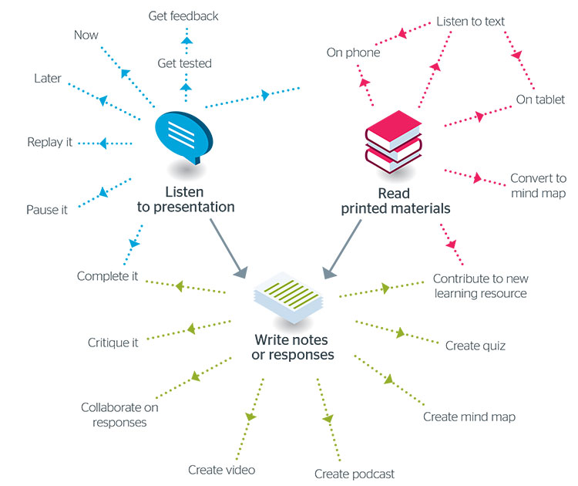
Personal productivity
Giving the learner control and independence.
Digital skills
Tools
Confidence
Innovation
Notes:
Digital diversity, Facilitating their successful personal productivity and independence.
Providing options that support different needs and encourage independence is at the core of this. Enabling and entitling students to have more control and responsibility. Providing the skills, the tools, apps and accessible resources for them to make good use of digital solutions for themselves.
Staff don’t always have the time and digital skills and tools or the confidence to support learners. How can we address this?

Slide 12
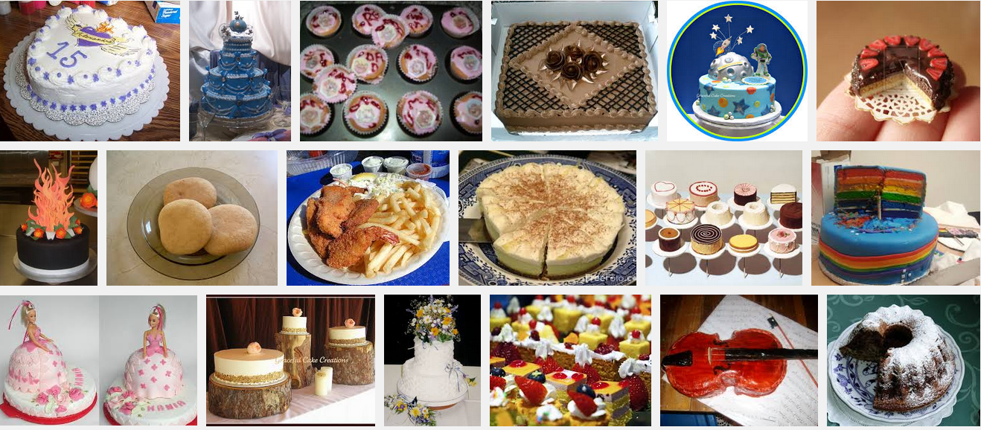
A critical mass of ingredients…
Paper
Pens
Mindmap
Audio
Image
Video
screen capture
Text to speech
Notes:
Critical mass of ingredients
It is helpful to think in terms of a critical mass of ingredients. If your ingredients are simply paper and pens or text based information then your repertoire of approaches is likely to be limited. As you add new ingredients (for example audio recording image recording video or screen capture and text-to-speech) you pass a critical mass which allows teaching to become much more creative and flexible, adapting to the needs of individuals. Inclusive practice aims to meet as many people’s needs as possible. So the typical model of listening to a tutor, taking notes and writing an essay in response isn't inclusive. It already disadvantages those who find reading and writing difficult. The image is a screenshot of a Google search for cakes. It includes a huge variety of styles and decorations. The key point here reinforces the idea of the critical mass of ingredients. If you have flour, oil and water at your disposal you can make flatbread if you add milk and egg you can create pancakes. Add sugar and a whole new world of cakes appears. It is the same for consumers of our information when new tools are embraced
However, having said that the greatest seafarers on earth, the Polynesians, taught their superb navigation skills thousand years ago using role-play, representations of constellations using pebbles on the floor and a wide range of highly active low-tech methods. Ultimately the major constraint is the imagination of the tutor and the rapport built with the learners - but the more tools you have at your disposal the more ingredients your imagination can act upon.

Slide 13
Question
How comfortable are you using technology to support students find solutions to barriers they might be experiencing?
Extremely confident (I use technology all the time)
Fairly confident
Confident
Not too confident
Not confident at all (I never use technology)
To answer this question go to
www.govote.at
and use the code
47 98 93
or scan this code below
Notes:
Question – poll
Help me get an idea of where you feel you are in terms of using technology - remember this is anonymised so don’t worry about others seeing/knowing your responses.

Slide 14
Hidden in your computer – producing accessing information
  How do you make sure your Word documents are accessible?
How do you make sure that the PDF documents you save from my word documents are accessible?
How can you make sure your PowerPoint slides are accessible?
How do you make sure your multimedia resources are accessible?
What about alternative formats such as text-to-speech?
Notes:
How do you make sure your Word documents are accessible?
How do you make sure that the PDF documents you save from my word documents are accessible?
How can you make sure your PowerPoint slides are accessible?
How do you make sure your multimedia resources are accessible?
What about alternative formats such as text-to-speech?

Slide 15
Microsoft Word documents: Accessibility basics
Keep the layout simple and clear.
Use san serif fonts.
Use heading styles to create clear document structure.
Make sure pages are numbered.
Use recognised rather than ‘unofficial’ formatting.
Make sure images and diagrams have alternative text descriptions.
Use plain English.
Ensure that printed handouts are also available in electronic format.
Use the Microsoft Word Accessibility Checker.
Read the advice from Jisc at Jisc Accessible Content
Notes:
Keep the layout simple and clear.
Use san serif fonts.
Use heading styles to create clear document structure.
Make sure pages are numbered.
Use recognised rather than ‘unofficial’ formatting.
Make sure images and diagrams have alternative text descriptions.
Use plain English.
Ensure that printed handouts are also available in electronic format.
Use the Microsoft Word Accessibility Checker.
Read the advice from Jisc at http://tiny.cc/JiscAccessibleContent

Slide 16
Font: ensure all text is left aligned, not justified
Notes:
Underlining of large volumes of text should be avoided as the readability is significantly decreased.
DON’T WRITE WHOLE SENTENCES IN CAPITALS. (Interestingly this can be undone by pressing shift and F3)
Don’t use italics to emphasise; consider using bold instead.

Slide 17
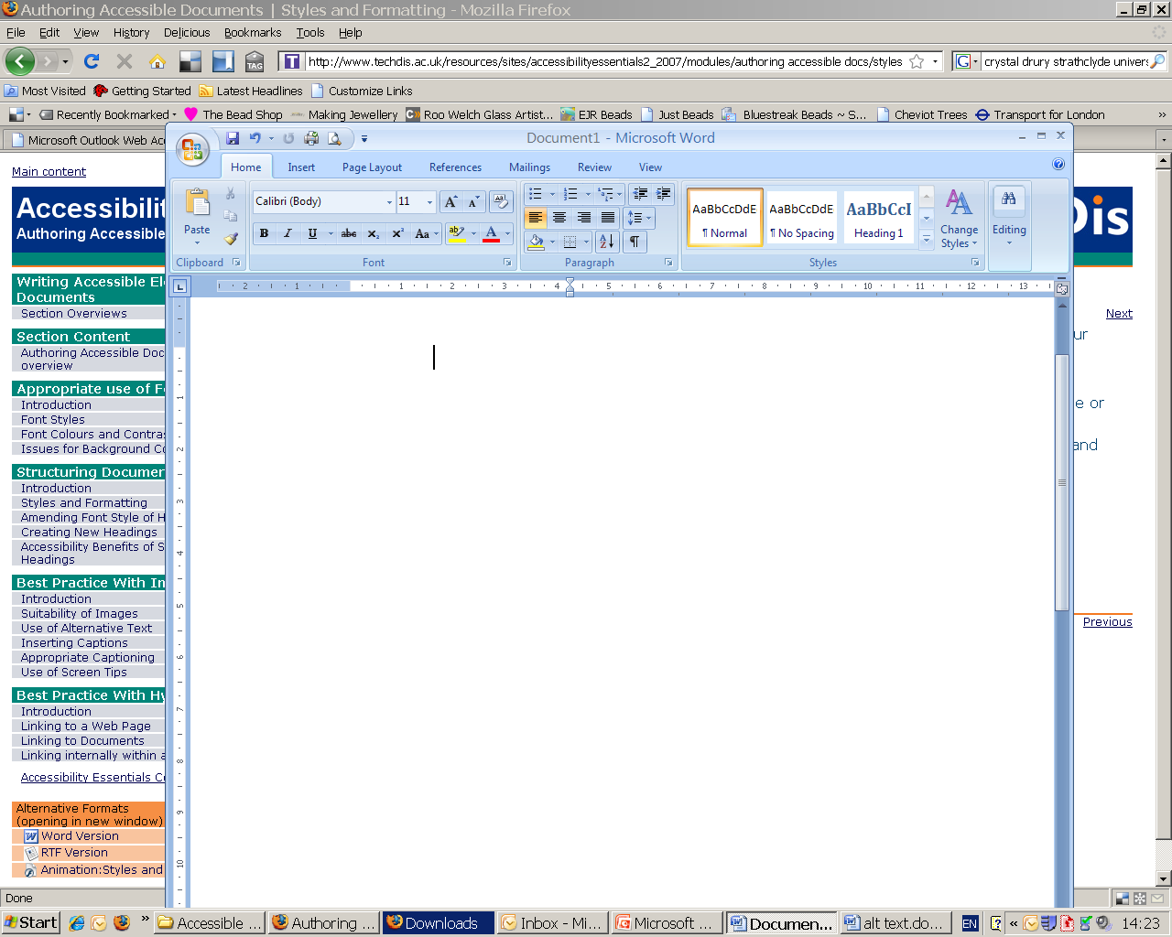
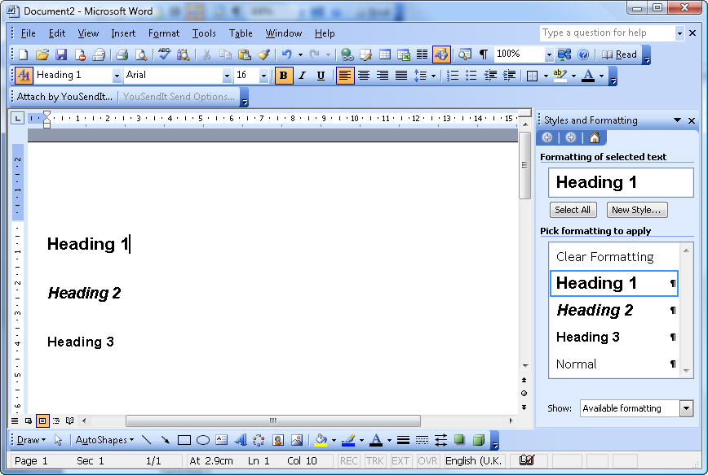
Structuring Documents
Using built in heading styles
Microsoft ® Word has an inbuilt structuring system for heading styles which should be used when creating any document
Notes:
Microsoft ® Word has an inbuilt structuring system (Format / Styles and Formatting) which should be used when creating any document. When the structuring system is used appropriately users can effectively navigate a document. If it is not already visible, open the formatting toolbar, go to view > toolbars > formatting.
Adding structure in heading styles in to your documents is arguably the most important thing you can do.
Easy to do – using inbuilt heading styles. Make them look exactly as you want them. On paper you could not tell the difference BUT when you look at electronically is infinitely easier to navigatehas infinitely more accessible to a wide range of AT. Can also be exported to mind mapping software.
Heading styles should be used to note headings and sub-headings and the main body of text thus providing an intrinsic structure which enables the learner to adapt his/her word documents to suit their needs
If tutors format a document using the inbuilt styles (e.g. Heading 1, Heading 2 etc) every learner benefits, especially those with accessibility needs. In a Word document print challenged learners can view the document map (View > Document map) for an instant overview of the document.

Slide 18

What do you think are the accessibility benefits of using built in heading styles?
Notes:
What do you think are the accessibility benefits of using built in heading styles?
Follow this link and add your thoughts onto our shared online padlet

Slide 19
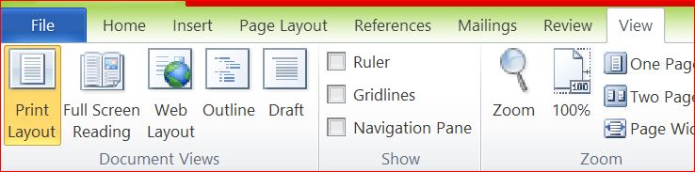
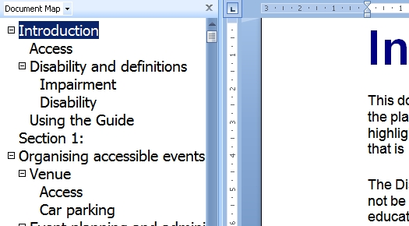

Using built in heading styles
http://tiny.cc/Navigation
Notes:
Accessibility without trying
Accessibility Benefits of Using Heading Styles.
Using the document map allows all the headings to be viewed on the left hand side of the page.
This makes it so much easier for screen readers and those with print disabilities to get a real
overview of the content of documents - especially long documents.
An image of the document map in view which allows a reader to view all the headings and sub
headings in a document.
There are 2 hyperlinks on this slide:
1. The first example is a 42 page document with no heading styles and difficult to navigate using a
document map or if someone is using a screen reader.
2. The second option is still a really large document but much more navigable via the heading structure.
Accessibility Benefit:
Users with visual impairments may rely on a screen magnifier for reading. A long document can be very awkward to navigate through a screen magnifier, requiring much horizontal as well as vertical scrolling.
Using the document map, a print impaired user can rapidly focus on the key concepts within the text without having to negotiate large volumes of text.
People with poorer English skills (for example, British Sign Language users or others for whom English is a second language) can extract the key concepts before negotiating the dense text.
A motor impaired user can access the whole document with minimal keyboard or mouse movement.
Users with learning difficulties can identify the main ideas of a lengthy document at a glance.
DAISY format/digital talking books look for heading styles when converting a document
A well structured document will provide the baseline for an accessible PDF document.
As we have seen, the screen reader software would read what is on screen. By using heading styles and having a document map, this allows for the main headings within the document to be captured, almost like a CD track.
You may not have a student who is a screen reader however you may in the next cohort of student enrolments.

Slide 20
Why heading styles are important?
“Without heading styles in electronic documents, it is difficult for me to read & often I am the one spending time making my course work accessible “
“As a screen reader user it is important for me to have heading structure in a Word document.“
“very time consuming scrolling down continuously not knowing and listening to information you don’t want to know about. “
Listen to a student who uses screen reading technology
Jisc Scotland Tube video

Slide 21
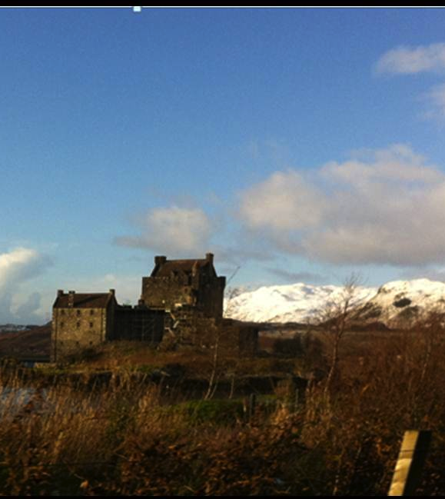
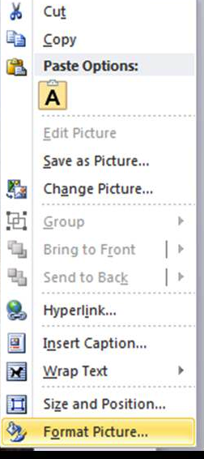
Adding alt text to images provides information for AT users
Right click your image and select format.
Choose the format picture/alt text.
Add an alt text that describes the image.
Notes:
Right click your image and select size (or in some cases format).
Choose the tab alt text.
Add an alt text that describes the image.

Slide 22
Alt Text Descriptions
“It’s important to have description of images to help a visually impaired person imagine what that image could be“
“Alt text gives me the idea of what the image, is not just a massive gap when the screen reader is reading back.“
Listen to Jennifer - screen reader user
Notes:
“It’s important to have description of images to help a visually impaired person imagine what that image could be“
“Alt text gives me the idea of what the image, is not just a massive gap when the screen reader is reading back.“

Slide 23
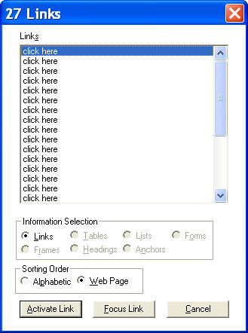
Hyperlinks should make sense out of context
Especially important for screen reader users who can opt to listen to hyperlinks as a summary of information.
The links need to make sense out of context.
Click here for Topic List.
Click here for Topic List.
Click here for Topic List.
Notes:
Hyperlinks should make sense out of context.
Especially important for screen reader users who can opt to listen to hyperlinks as a summary of information. The links need to make sense out of context.
Links
If you could pull out links into a separate alphabetical list for quick reference, and the link was the underlined part of the following, which would help you find the list of topics quickest?
Click here for Topic List (Linked part: Click here for topic list)
Click here for Topic List (Linked part: Click here)
Click here for Topic List (Linked part: Topic List)
Click here for List of Topics (Linked part: List of Topics)

Slide 24
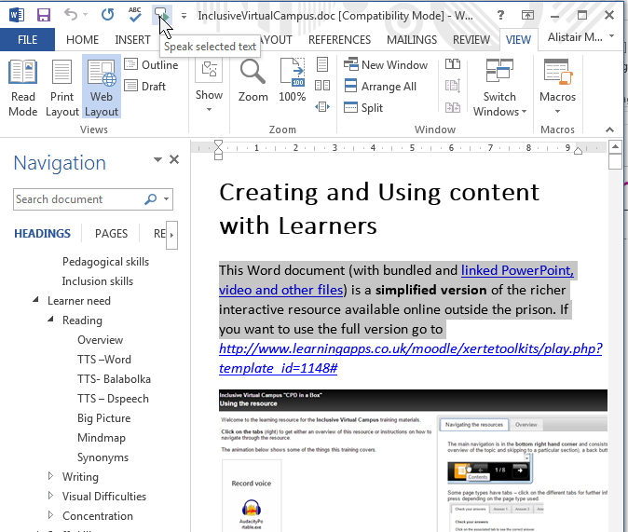
* Hidden in your computer – benefiting everyone
Text to speech:
Get instant text to speech (quality depends on your default system voice).
Web Layout view:
Get instant text reflow when you increase zoom level.
Navigation pane / document map view:
Get instant navigable heading/subheading summary
Colour change
Notes:
Hidden in plain sight
Microsoft Word has 3 key accessibility tools built into it:
Text-to-speech (ideally, this would be added to the Quick Access Toolbar on all PCs )
Web Layout view. This is a view that allows you to increase magnification as much as you like without having to scroll left and right to see the end of the line. It makes the lines automatically rewrap to fit the page.
Navigation pane/document map view; provided the people creating the documents have used heading styles for the headings and subheadings the navigation pane or document map view will give you an instant navigable summary of all the headings and subheadings in the document. This is a brilliant way of skim reading a document.

Slide 25
Hidden in your computer – benefiting everyone
Adding audio into your documents,
Insert video into documents,
Using autocorrect to remember commonly misspelt words or auto-text as a basic form of word prediction.
Notes:
If spelling correctly is always difficult it can be very demoralising. So it can help to have common words or phrases added to documents automatically using the auto-correct function. You won’t remember that but that’s why we have the videos available in the learning object you can see on screen.
I want to focus on Adding media which can help with understanding and recall.
You can add an image with a screen-tip to explain its relevance. You can even add a video or sound file to a Word document to support a reading activity.
Add from the insert menu or look from insert an object – browse to choose the saved file, music or something you have recorded yourself in Word or Powerpoint.

Slide 26
Hidden in plain sight – producing accessing information
Accessible PowerPoint
Accessible PDF
  I use the built in layout templates.
  I use the Notes Field to explain what the slide shows.
  I use hyperlinks to add additional information.
  I ensure hyperlinks have unique meaningful text (i.e. not “Click here” or “More”).
I make sure that when I ‘save as’ PDF that I choose the ‘options’ and ‘create bookmarks from headings’ option.
This carries over the built in headings to produce a structured PDF document.
More information
Notes:
Accessible PowerPoint
I use the built in layout templates.
I use the Notes Field to explain what the slide shows.
I use hyperlinks to add additional information.
I ensure hyperlinks have unique meaningful text (i.e. not “Click here” or “More”).
Accessible PDF
I make sure that when I ‘save as’ PDF that I choose the ‘options’ and ‘create bookmarks from headings’ option.
This carries over the built in headings to produce a structured PDF document.

Slide 27
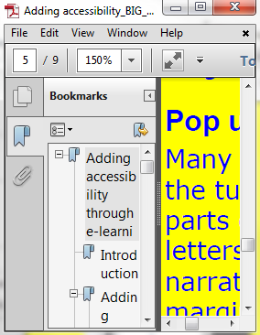
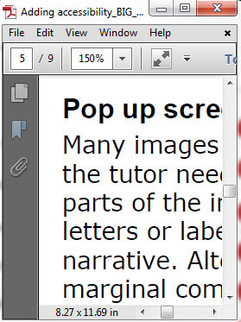
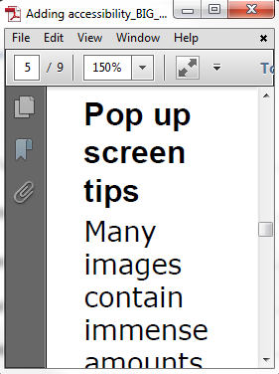
Accessibility features of Adobe Reader
Navigate
Magnify
Reflow
© Alistair McNaught Jisc
Notes:
Adobe reader – magnify, reflow and recolour

Slide 28
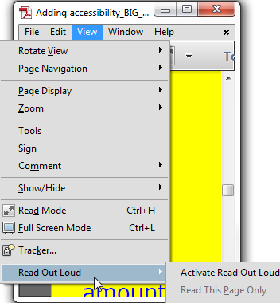
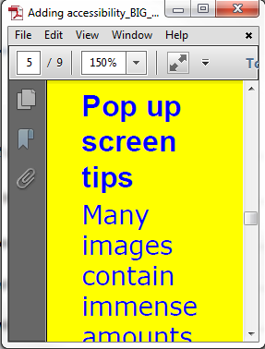
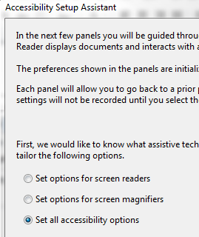
Accessibility features of Adobe Reader
Listen
Recolour
Interoperate
© Alistair McNaught Jisc
Notes:
adobe reader navigate using headings, listen via read out loud feature and choose specific accessibility options.
Many eBooks are presented in PDF format which offers opportunities to adapt the way that people access eBooks.

Slide 29

Different needs
Different Needs
Visual Learners
Struggling Readers
Auditory Learners
New to IT
Literacy Support
The international agenda
Notes:
Different Needs
Struggling Readers
Auditory Learners
New to IT
Visual Learners
Literacy Support
English Language Students

Slide 30
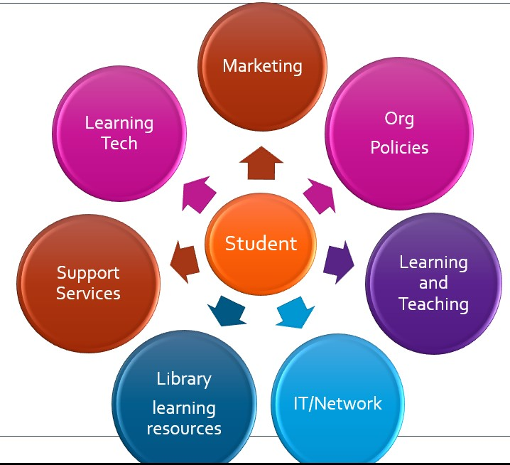
Mainstreaming inclusive practice
Notes:
Mainstreaming Inclusive Content We can think about inclusiveness in relation to:
If we are being systemic in the way that we approach inclusiveness , institutions need to consider the impact that inclusive policies can have at strategic level and the impact that these decisions can potentially have on everyday practice and ultimately on ‘end users’.

Slide 31







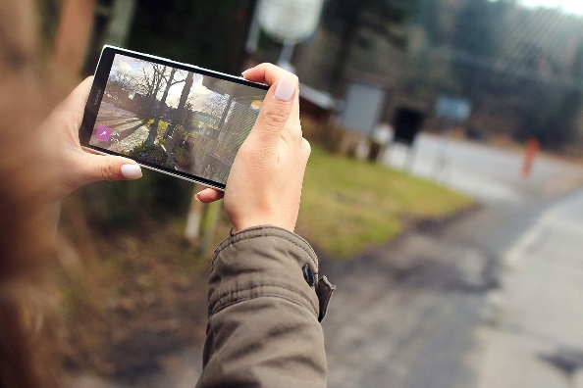


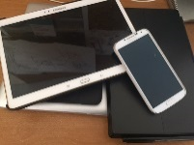

Exploiting ‘mundane’ technologies
Images from Pixabay
Notes:
Because technology has become more immersive maybe the way the students use technology for learning has become so too.
Maybe there is more of an overlap between the tools we use for leisure and for learning and maybe this offers an opportunity to look at how everyday technologies can be used as a hook to engage learners to bring learning to life.
Maybe it also offers a chance for us to unpack the ways that they can be used as tools for inclusion.
Should the technologies we use fit neatly into one category or another, or should it be more disruptive and lurk between the different facets of the learning/workplace/social spectrum bringing technologies that learners are comfortable with into play when it best fits with the way that they work and learn.
If our focus is putting the learner at the centre, how can we equip learners for learning and ultimately for the workplace by exploiting, investing and capitalising on their digital literacy skills - skills that they bring with them?
Can we use the technologies that students are more comfortable with as learning tools not just as cool new things?
Jo Morrison the founding Creative Director of Futurelab talked about ‘mundane technology’, she pointed out that mobile devices and digital technologies were often hiding in plain view and integral to day to day learning and to creative practices.
As my colleague Alistair McNaught says - technologies that are…
Hidden in the pocket
Hidden in the browser
Hidden in plain sight
Hidden by our influence

Slide 32
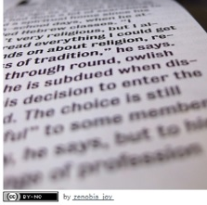
Making sense of text
Listening to text using free add-ons for Microsoft Office and the read outloud feature Adobe Reader,
Listening to text using tools like Texthelp Read and Write Gold, Claro Read, Balabolka and Orato
Using free built in speak features,
Listen to Firefox webpages using Google Text to Speech add on,
Personalise the way webpages are viewed by adjusting the colour contrast and text size and magnification,
Remove distracting content on cluttered webpages using the Clearly add on,
Reading summaries or highlights of written text to understand it better.
Notes:
How can we take advantage of tools to help learners become more agile in their learning and resilient in the way that they can use their technologies in the different places and circumstances that they may be presented with?
If the tools I’m going to refer to are familiar to you, please treat this as a refresher.
Thinking about tools can be used to listen to text, to make reading more comfortable on the eyes, to remove distraction, to summarise content
Going to put on my screen share and demonstrate a few of the examples that I mention on this slide:
Firstly thinking about the everyday tools that we use and are familiar with - Adobe Reader, doesn't highlight.
Claro read for google chrome and in google drive,
Texthelp read and right for google chrome and in google drive,
Using text to speech tools (such as the built in speak feature in Word) to help with proof reading (screen share and demo).

Slide 33
5 mins activity - Making Sense of Text
Making Sense of Text -
Making Sense of Text
Have a look at this link and spend 5 minutes exploring the links in the ‘you can try’ section to and learn more about the examples offered.
If you have headphones you might choose to listen to one of the video clips in the relevant web page.
Notes:
I talked earlier about how technology can support productivity in the workplace and I these links will offer more additional supporting information which I hope will be of assistance
5 mins activity
Making sense of text - http://tiny.cc/Sense-of-Text
Have a look at this link and spend 5 minutes exploring the links in the ‘you can try’ section to and learn more about the examples offered.
If you have headphones you might choose to listen to one of the video clips in the relevant web page.

Slide 34
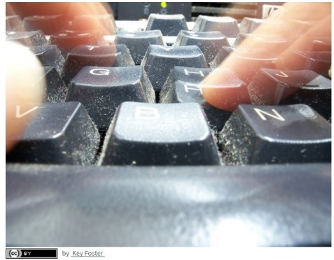
Supporting writing
Dictating information on a mobile device e.g. Apple or Android voice recognition,
Dictating using a web plugin such as VoiceNote2,
Dictating using Dragon Naturally Speaking or the built in Windows Speech Recognition,
Word prediction on Apple devices using Quicktype,
Word prediction using Texthelp Read and Write Gold or other free and portable alternatives,
Proof reading written work using the text to speech tools mentioned previously,
Recording information using mobile apps*.
Notes:
Dictation software has improved over the years, voice recognition tools such as Dragon naturally speaking or build voice recognition features on computers have become more sophisticated, more accurate and can make a really difference for people who find writing difficult.
But other features such as audio recording tools on mobile devices are helpful for capturing voice memos, for capturing information instead of writing, especially on the go.
Word prediction can help ease the burden of writing and text to speech tools as mentioned previously can be great for proof reading.
Using text to speech tools (such as the built in speak feature in Word) to help with proof reading (screen share and demo).
5 mins activity
Making sense of text - http://tiny.cc/Sense-of-Text
Have a look at this link and spend 5 minutes exploring the links in the ‘you can try’ section to and learn more about the examples offered.
If you have headphones you might choose to listen to one of the video clips in the relevant web page.

Slide 35
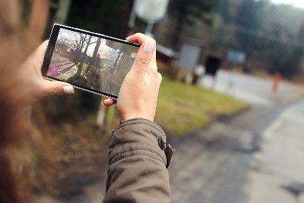
Remembering
Capturing images video on mobile devices*,
Using built in voice recorders to capture spoken information,
Using audio note* or similar apps to record information and augment by adding text and audio for review and revision,
Using text to speech to listen rather than reading it,
Watching instructional videos again and again*.
Notes:
Again mobile technology provides the capacity to
to help improve focus
Capture information,
Record notes rather than write them, (thinking back to Julie and other really interesting examples where students have used mobile apps such as audio note or educreations to capture information by text and by audio). - http://www.rsc-scotland.org/?p=2039
Or using text to speech to help assimilate information and remember it by listening rather than reading it,
To watch instructional videos again and again.

Slide 36
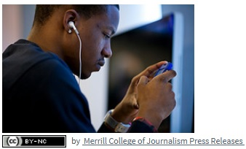
Planning, organising and searching
Searching using voice based ‘personal assistance’ tools such as using Siri or OK Google,
Using mind mapping software to plan projects*, document things to do or visually plan a structure for a written project,
Using web/app based planning management tools.
Notes:
Searching using voice based ‘personal assistance tools such as using siri or OK Google can be really useful ways of finding information quickly,
Using mind mapping software to plan projects, document things to do or visually plan a structure for a written project, can really help
interesting case study from City of Glasgow where student used Mindjet free app to create mind maps on her iPad. She had the paid for version on her PC and worked between both devices
So if we are considering the use of these tools
Do we know what these resources are and what they can do?
Do others in your institutions?
How can we share these possibilities with learners? With colleagues?
In turn how does your institutions or your service share this with learners and with others so that they can become more familiar with them too?

Slide 37
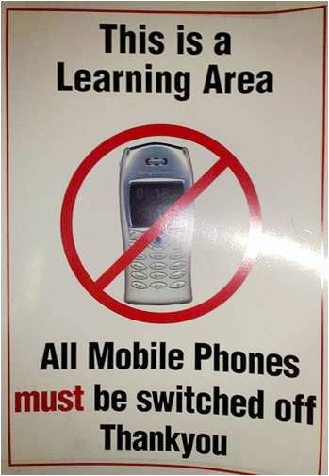
James Clay, Mobile:The State of Play University of Bolton 15 June 2010
Notes:
Discouraged
This is a learning area all phones must be switched off
Now students are encouraged to use their mobile devices.

Slide 38
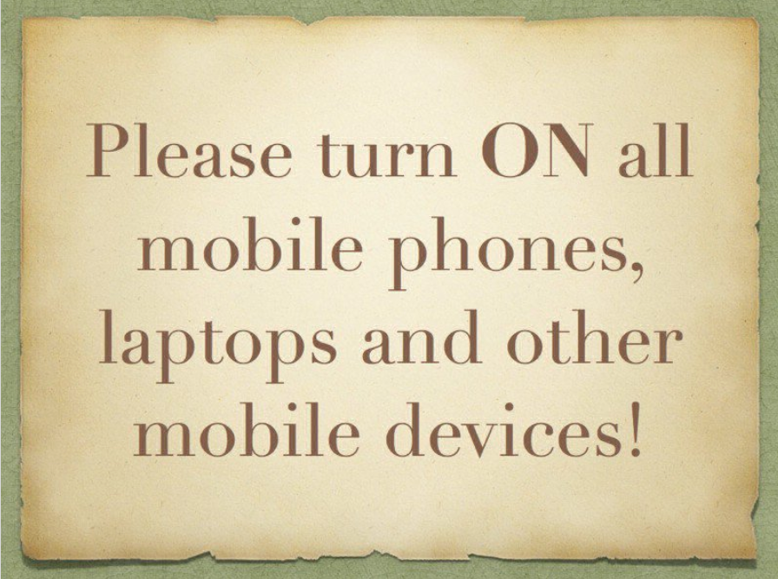
James Clay, Mobile:The State of Play University of Bolton 15 June 2010
Notes:
Encouraged
This is a learning area all phones must be switched off
Now students are encouraged to use their mobile devices.

Slide 39
For many learners it is important to
have devices that don’t say
“I have a disability!”
as soon as you walk into a
room with one.
Rummel-Hudson, R.
Making weird cool 5 April 2010
Notes:
For many learners it is important to
have devices that don’t say
“I have a disability!”
as soon as you walk into a
room with one.
Rummel-Hudson, R.
Making weird cool 5 April 2010,
http://tinyurl.com/3236qbq

Slide 40
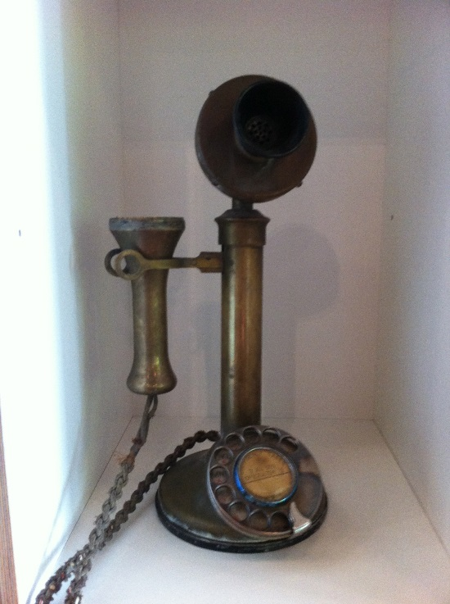
Inclusive Mobile Learning
A practical guide for educational organisations planning to implement a mobile learning initiative
Inclusive Mobile Learning
Notes:
Move on and look at some practical examples of how technology being used in learning.
In 2015 Jisc conducted a study into the use of technology in higher and further education - study was called ‘Just Snapchat me’ - the new way to stay in touch with university tutors
That study, completed just a year ago, showed that 40% of students were using social media to communicate with their lecturers, that 28% were using smartphones to draft their essays and that 30% used tablets to support their studying.
Another initiative that jisc were involved in over the last year was to add to the mobile learning guide and we invited institutions who used mobile technologies with learners to share their experiences. Examples from across the UK – a lot from the independent specialist colleges south of the border.
Pictello to create visual recipes which were shared with the class wirelessly using Apple TV
How they used the built in iPad photo tool as a communication tool in gardening classes.
My Choice Pad and Story Creator apps for students with learning and communication difficulties to help build evidence for work portfolios.
Grid 2 software and Grid Player mobile app into the class to enhance the learning experience
The Royal National College for the Blind describe their Tech Novice Café where they provide peer support and 1:1 tuition for older blind people who want to learn about how to use technology to access information.
create eBooks and video CVs using Book Creator, Storybird and iMovie. They also use an app called Kaleido as part of the sensory art session.

Slide 41
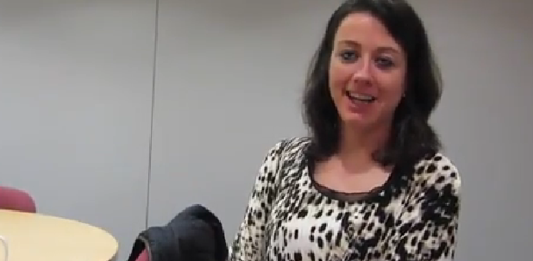
Listen to Julie: My way!
My iPad as my productivity tool
Notes:
(my ipad video on right hand side of interface) – remember to mute mic.
After video –
This video of Julie demonstrates just that, she talks about the fact that she tried other more traditional approaches but found that her iPad was the go-to tool for her which allowed her to accomplish different aspects of her learning in a more immersive and independent manner.

Slide 42
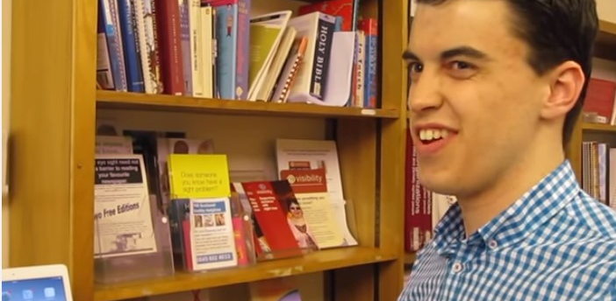
Listen to Matthew: My way!
The accessibility eco-system within Apple
Matthew Mobile
Notes:
(my ipad video on right hand side of interface) – remember to mute mic.
After video –
This video of Julie demonstrates just that, she talks about the fact that she tried other more traditional approaches but found that her iPad was the go-to tool for her which allowed her to accomplish different aspects of her learning in a more immersive and independent manner.

Slide 43
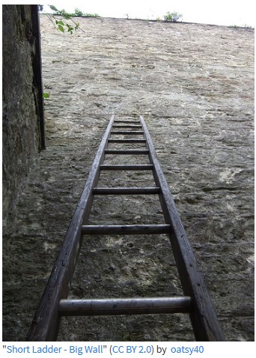
Inclusion for all learners

Slide 44
Reasonable Expectations
Clarity of expectations – do learners know what they are entitled to expect?
Student satisfaction surveys are an increasingly powerful tool for change. However, the FE support experience of disabled learners is very varied.
Many do not know what would be 'reasonable' for them to expect. How do your students know what they are entitled to in terms of tools, good practice with lectures/seminars etc?
http://tiny.cc/reasonable-expectations

Slide 45
Jisc Quick and Detailed Guides
Getting started with accessibility and inclusion
Meeting the needs of learners with special educational needs
Accessible documents, presentations and spreadsheets
Enhancing staff support for learners with disabilities
Using assistive and accessible technology in teaching and learning
Using assistive and accessible technology in teaching and learning
Delivering an inclusive digital student experience
Notes:
Quick and detailed
Getting started with accessibility and inclusion
Meeting the needs of learners with special educational needs
Accessible documents, presentations and spreadsheets
Enhancing staff support for learners with disabilities
Using assistive and accessible technology in teaching and learning
Using assistive and accessible technology in teaching and learning
Delivering an inclusive digital student experience

Slide 46
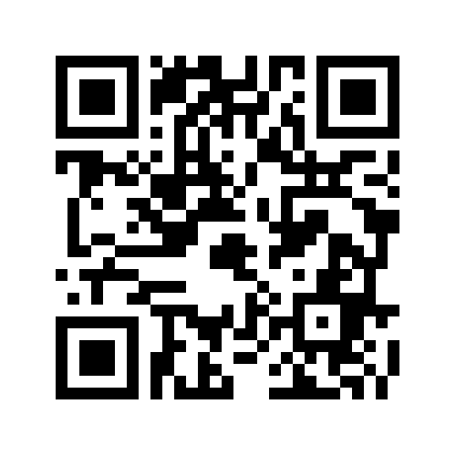
Padlet Activity: Examples of inclusive practice
Can you think of any examples of inclusive practice where technology has been involved?
Maybe something that you have seen, have influenced or maybe initiated?
Follow this link:
Share Examples of Inclusive Practice
to add your ideas or scan the QR code

Slide 47
Jisc Blogs
Spotlight on visual inclusion – supporting learners with sight loss
Can the digital world help us harness positive mental health?
The textbook challenge: supporting literacy through technology
Are you using mobile technologies to support inclusive practice?
How can you make resources accessible for those with disabilities?
Accessible organisations
Notes:
Blogs
Spotlight on visual inclusion – supporting learners with sight loss
Can the digital world help us harness positive mental health?
The textbook challenge: supporting literacy through technology
Are you using mobile technologies to support inclusive practice?
How can you make resources accessible for those with disabilities?
Accessible organisations

Slide 48
References
Making sense of text – Making Sense of Text
Supporting writing and notetaking - Supporting Writing and Notetaking
Remembering information - Tools to Help Us Remember
Planning, organising & searching – Planning, Organising and Searching
Notes:
I talked earlier about how technology can support productivity in the workplace and I these links will offer more additional supporting information which I hope will be of assistance
Making sense of text - http://tiny.cc/Sense-of-Text
Supporting writing and notetaking - http://tiny.cc/writing-notetaking
Remembering information - http://tiny.cc/remembering
Planning, organising & searching - http://tiny.cc/planning-searching

Slide 49
margaret.mckay@jisc.ac.uk
Twitter: @Mags_McKay
Skype: Margaret.Jisc
Mobile: 07443 984444

