Slide 1
LEAD SCOTLAND

Slide 2
Company Overview
LEAD SCOTLAND
DSA Suppliers
Access to Work Suppliers
E-learning
SQA Customised Award
ASN Access Fund
www.conceptnorthern.co.uk
Notes:
Largest supplier to Universities and Colleges in Scotland and Northern England – supply of assistive technology and experienced trainers who coach the students on the equipment.
One of DWP’s preferred ATW suppliers in Scotland – similar to DSA but in the workplace
e-Learning – Concept Learning is our free website for students and assessors with courses purchased from all over the world. Assisting other NTP’s with their training material (WM Café)
SQA Award worth 20 credit points being used as a CPD or employability route for those with Dyslexia (only one of its kind in Britain… possibly the world?)
Recently ASN Access Funds for those on Employability Funding Courses. We can assist other NTP’s to hit their milestones and help those who need assistance to reach their goals.

Slide 3
LEAD SCOTLAND
ASN Access Fund
Bespoke Needs Assessment
Identify individuals needs
Detailed recommendations
Implementation of Assistive Technology
Increased success in EF programmes
www.conceptnorthern.co.uk
Notes:
By combining skilled assistive technology trainers and experienced modern apprenticeship assessors we can provide a truly bespoke needs assessment.
This assessment helps us identify an individuals needs and any problematic areas, allowing us to make detailed recommendations.
By implementing this assistive technology we can significantly increase the likelihood of an individual completing their EF programme or a modern apprenticeship.
ALL FUNDED BY ASN ACCESS FUND

Slide 4
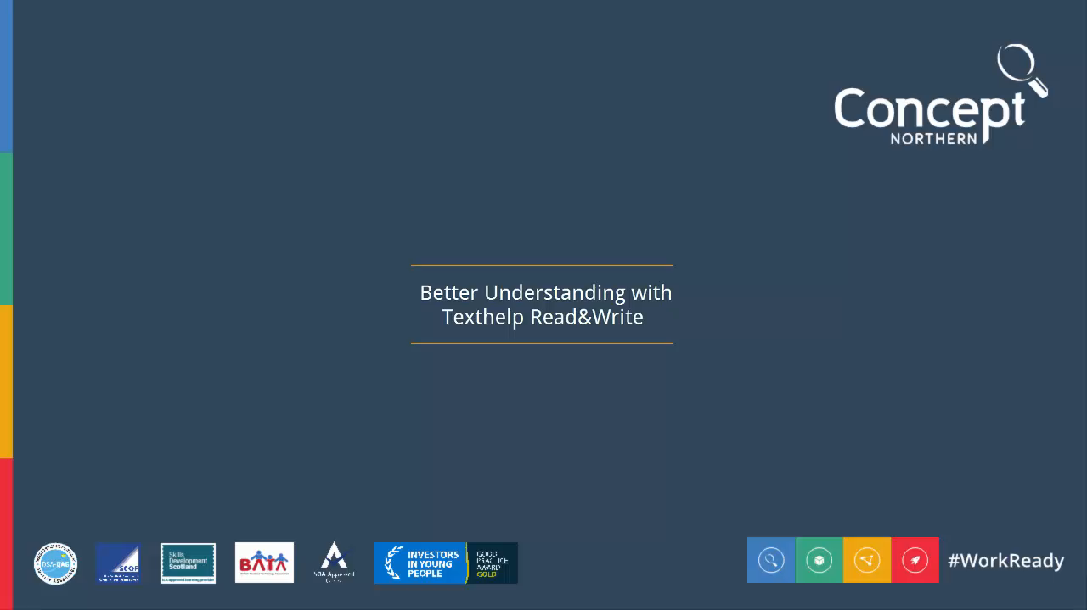
Texthelp
LEAD SCOTLAND
www.conceptnorthern.co.uk
Notes:
TextHelp – now going to show some brief videos, that I hope will give you a better understanding of the software we have been using.
Feel free to see me later if you’d like a play about with the software.
Firstly we will look at TextHelp literacy support software and demonstrate just two of the features that are crucial in aiding dyslexic candidates.

Slide 5

MindView
LEAD SCOTLAND
www.conceptnorthern.co.uk
Notes:
So we’ve seen how TextHelp can help with literacy support for individuals with dyslexia, now lets see how Mind Mapping software can assist with the memory issues that Dyslexia can cause.
Those of you with a keen eye for detail will probably see that Alex is a mature apprentice… a very mature apprentice… who had a paper run in the French Alps!!!!

Slide 6
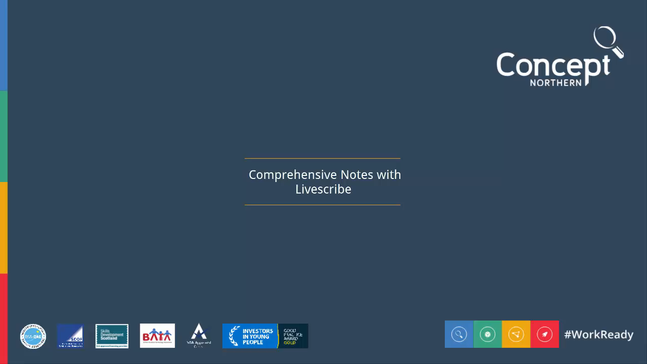
Livescribe
LEAD SCOTLAND
www.conceptnorthern.co.uk
Notes:
Our last piece of software is definitely one of the coolest!
Livescribe with the Echo pen is something that benefits dyslexic candidates, and to be honest, anyone who likes to take notes at meetings and lectures!!!

Slide 7
LEAD SCOTLAND
Customised Training
Specific training plan
Learning hours & Homework
Dyslexia & Neurological awareness training
www.conceptnorthern.co.uk
Notes:
Training plan – each training plan is specific to the individual. We appreciate that not every person regardless of their disability will display the same traits.
Aim for four half days training on the software, with customised homework specific to an individuals career or educational goals.
Training for NTP’s on spotting and dealing with dyslexia

Slide 8
Outcomes
LEAD SCOTLAND
Transferable skills
Confidence and independence
Better knowledge & understanding
Software stays with the NTP
Dyslexia Awareness Training
www.conceptnorthern.co.uk

Slide 9
Progression
LEAD SCOTLAND
Modern Apprenticeships
Access to Work
DSA
Step-by-step assistance to sustained employment
www.conceptnorthern.co.uk
Notes:
With our help, candidates can successfully complete their EF program and use their newly transferable skills in a Modern Apprenticeship, further education or a working environment.
Once a candidate has decided on their progression route, Concept Northern can support them using DSA or ATW funding, providing the individual with step-by-step assistance.

