Slide 1



Help! We have a Deaf Student
LEAD Conference 9 June 2016

Slide 2
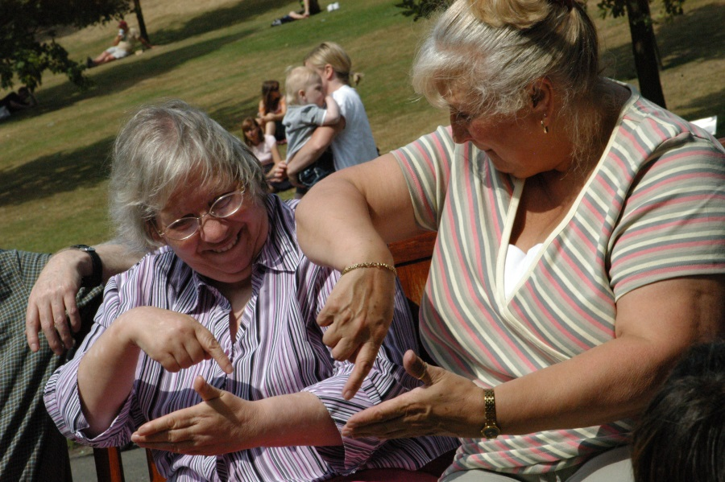
So to start…….
What does British Sign Language (BSL) mean to you?
Who are the people who use it?

Slide 3
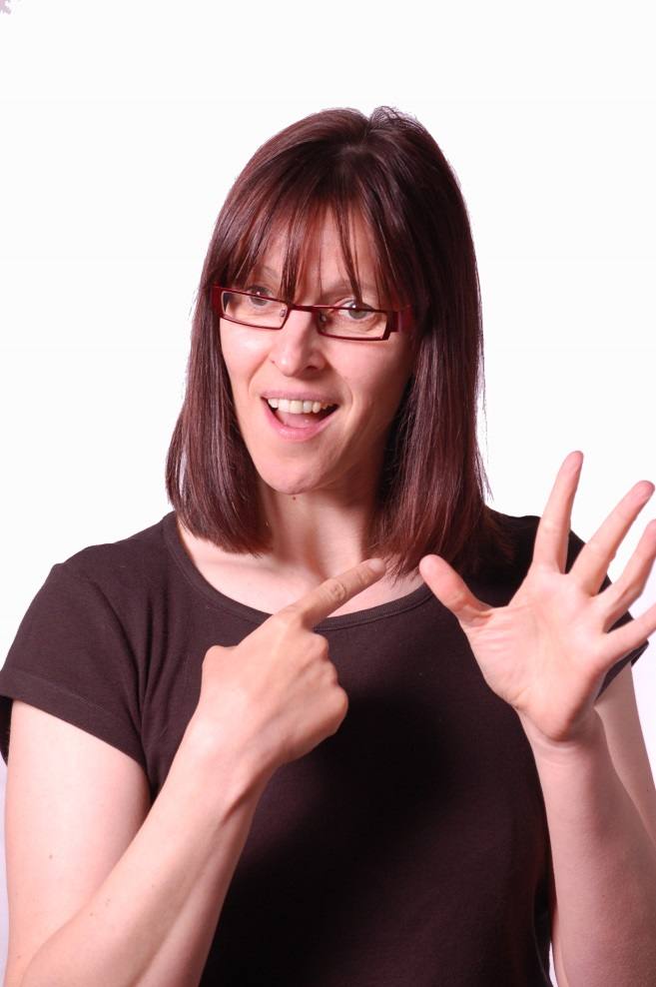
British Sign Language (BSL)
BSL is a language in its own right & was recognised as such in March 2003
It is a visual-spatial language
It has its own grammar

Slide 4
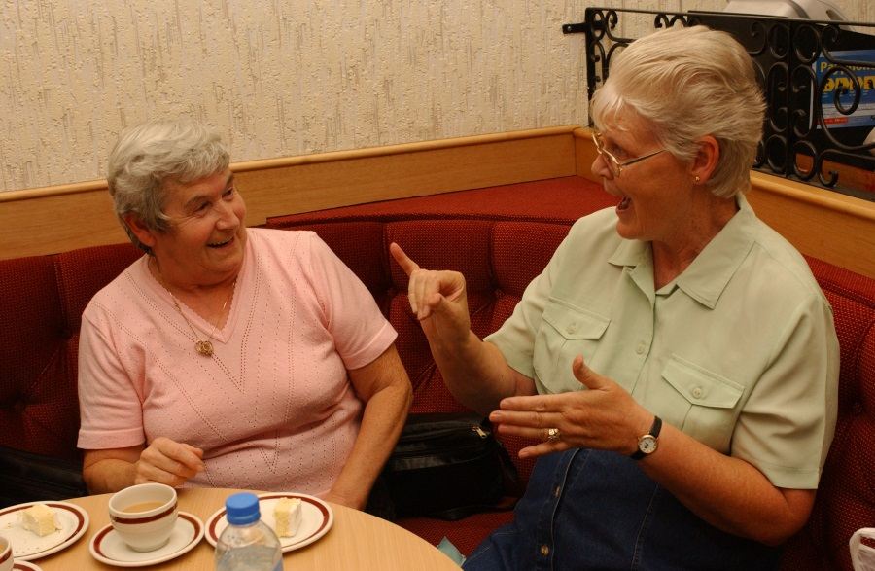
Who uses BSL?
The Deaf community (many of whom consider themselves to belong to a cultural & linguistic minority group)
Some of the families & friends of Deaf people
Works with Deaf people e.g. social workers, support workers, teachers & interpreters

Slide 5

Interpreter V CSW

Slide 6
What is the difference?
Interpreter
CSW – Communication Support Worker
Specifically trained to interpret between English and BSL
Knowledgeable about Deaf and hearing people
Committed to undertaking continuous professional development
Bound by a professional code of conduct
Employed to work for both parties
Work mainly within the education sector
Work between English and BSL
Work as part of the educational team
Support students by e.g. notetaking, adapt learning materials

Slide 7
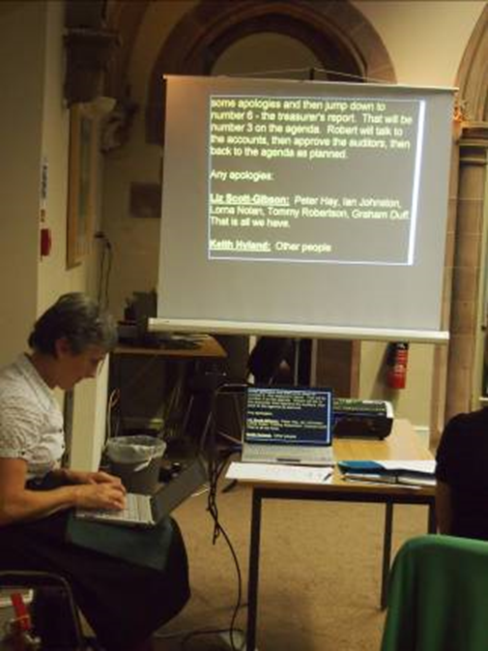
Additional support
Electronic Notetakers
Type what is being said onto a laptop or large screen
BSL users find this helpful for notes

Slide 8
The Tale of Molly
Simulated experience of interprting

Slide 9
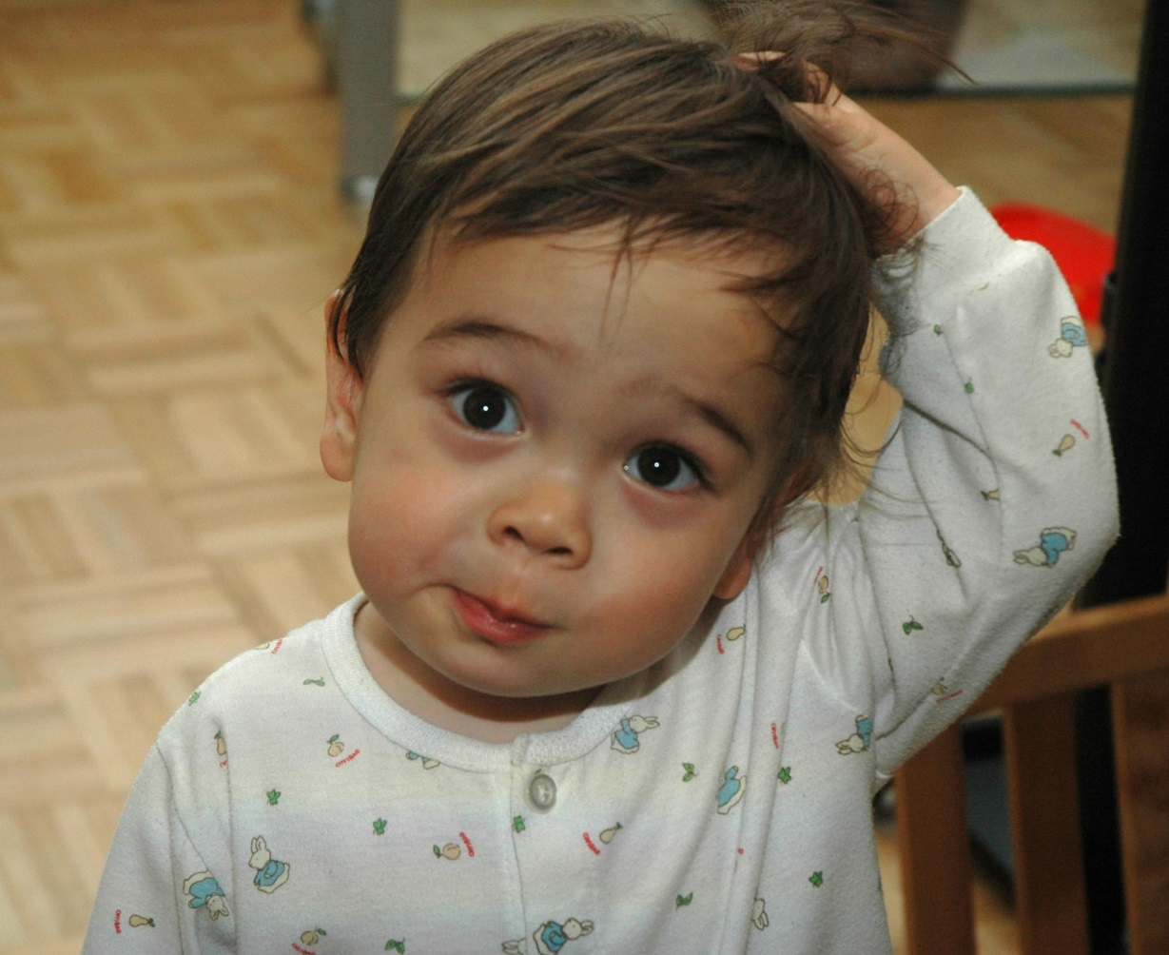
How was that?
What helped the process?
What hindered the process?

Slide 10
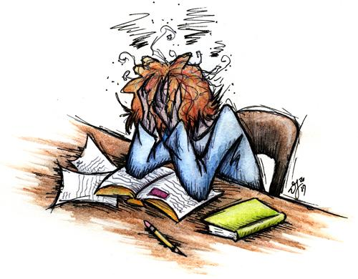
If there is nothing……..
Fewer Deaf applicants
Stressed students
Stressed lecturers
Mis-communication
High drop out rate

Slide 11
Communication let me down!
How would you communicate with a Deaf student?
Do you have any experience of this?

Slide 12
“Can’t they just lipread?”
Only 30-40% of words are visible on the lips
Some words and letters look similar e.g. post, boast, most, moat
These words have different meanings!
Need to know the subject of the conversation
Tiring

Slide 13

Lipreading is easy
Find a partner
Person A read the sentences with no voice!
Person B – did you understand?
Reverse process
How was that?

Slide 14

Booking
Interpreters registered with SASLI or NRCPD
Trainee or Qualified
Code of Conduct
CPD

Slide 15

Booking
CSW
Deaf Action has a list
Working at a minimum Level 3 BSL
Skills tested and interviewed

Slide 16
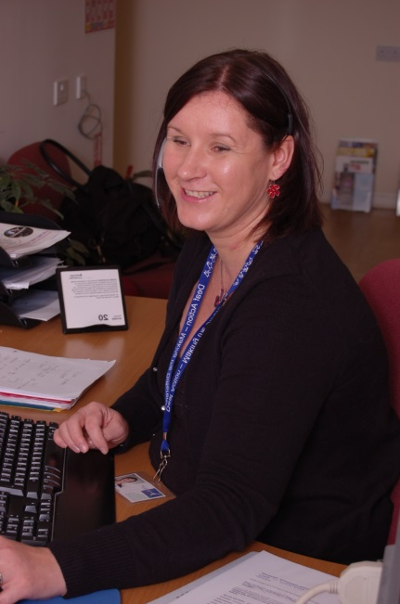
How to book
Phone: 0800 014 1401
E-mail: bookings@deafaction.org
SMS only: 07797 800 064
Fax: 0131 557 8283
Deaf Action

Slide 17
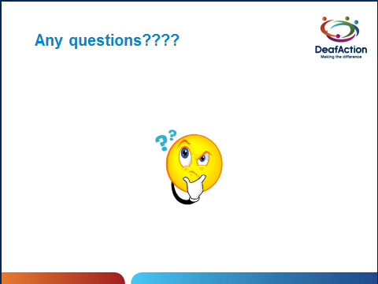

Slide 18
Thanks!
Shaurna Dickson
0131 550 0999
shaurna.dickson@deafaction.org

