Slide 1
How inclusive is open education?
Keith Smyth
University of the Highlands and Islands
@smythkrs
Lead Scotland Conference 9th June 2016

Slide 2

What we’ll explore…
What do we mean by ‘open education’?
Why is open education important?
Really open online education
Open education and disability
Where might we go from here?

Slide 3
Two framing propositions The most effective uses of technology in education are about providing spaces to create and engage Online technology is key to inclusive education, but we need to refocus the open education debate on physical spaces and locations

Slide 4
What do we mean by ‘open education’?

Slide 5
Is it just about…
Massive
Open
Online
Courses?

Slide 6

The concept of ‘third space’

Slide 7
Key characteristics of ‘third spaces’
Not work and not home
Neutral group where difference embraced
Social status is irrelevant
Sharing of knowledge for a colletive good
Bringing together those who may not meet
Amplyfying issues beyond the ‘third space’
Notes:
Kris Gutierrez. Nemanja Memarovic.

Slide 8



Open education in the community

Slide 9
Why is open education important?

Slide 10
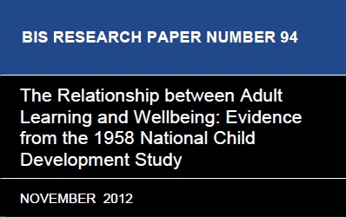

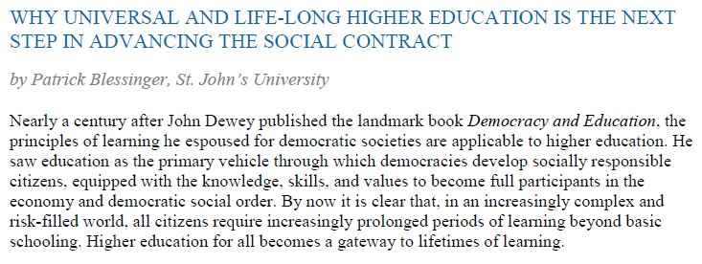
Education and social wellbeing
http://www.scholarsstrategynetwork.org/sites/default/files/ssn-key-findings-blessinger-on-universal-higher-education_0.pdf

Slide 11
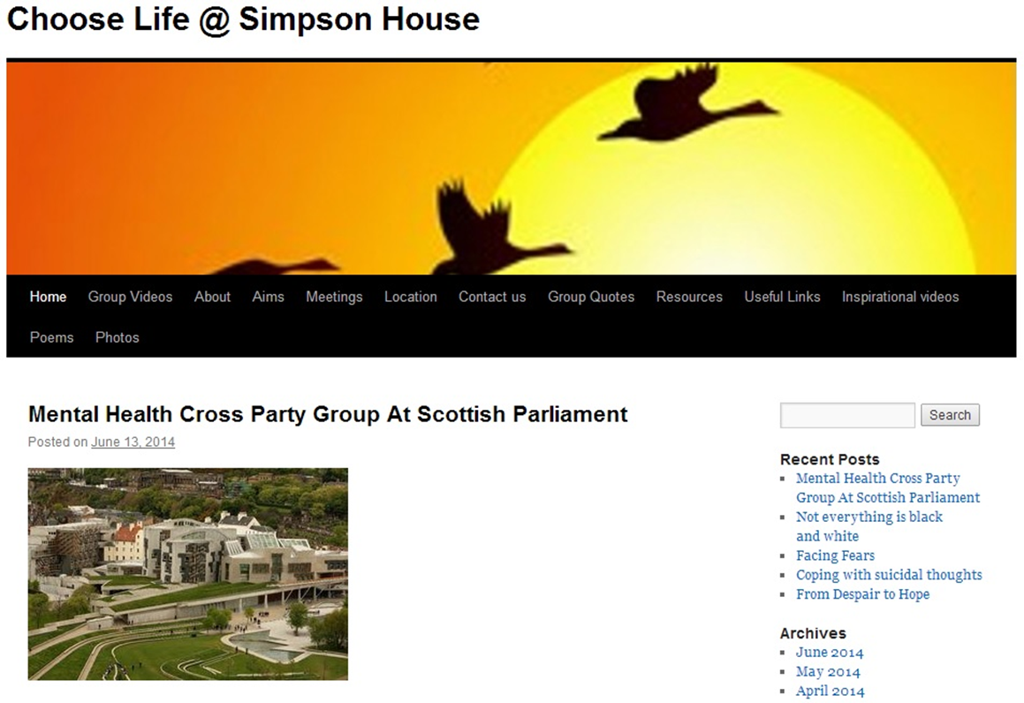
Social outreach and inclusion

Slide 12
Really open online education…

Slide 13
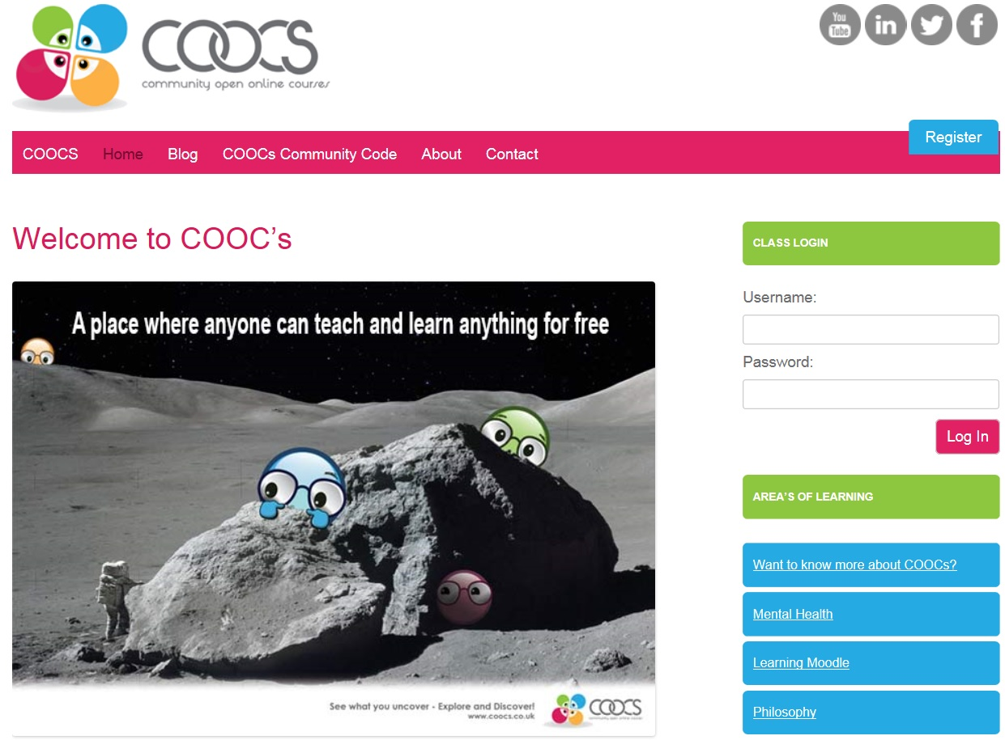
Community Open Online Courses

Slide 14
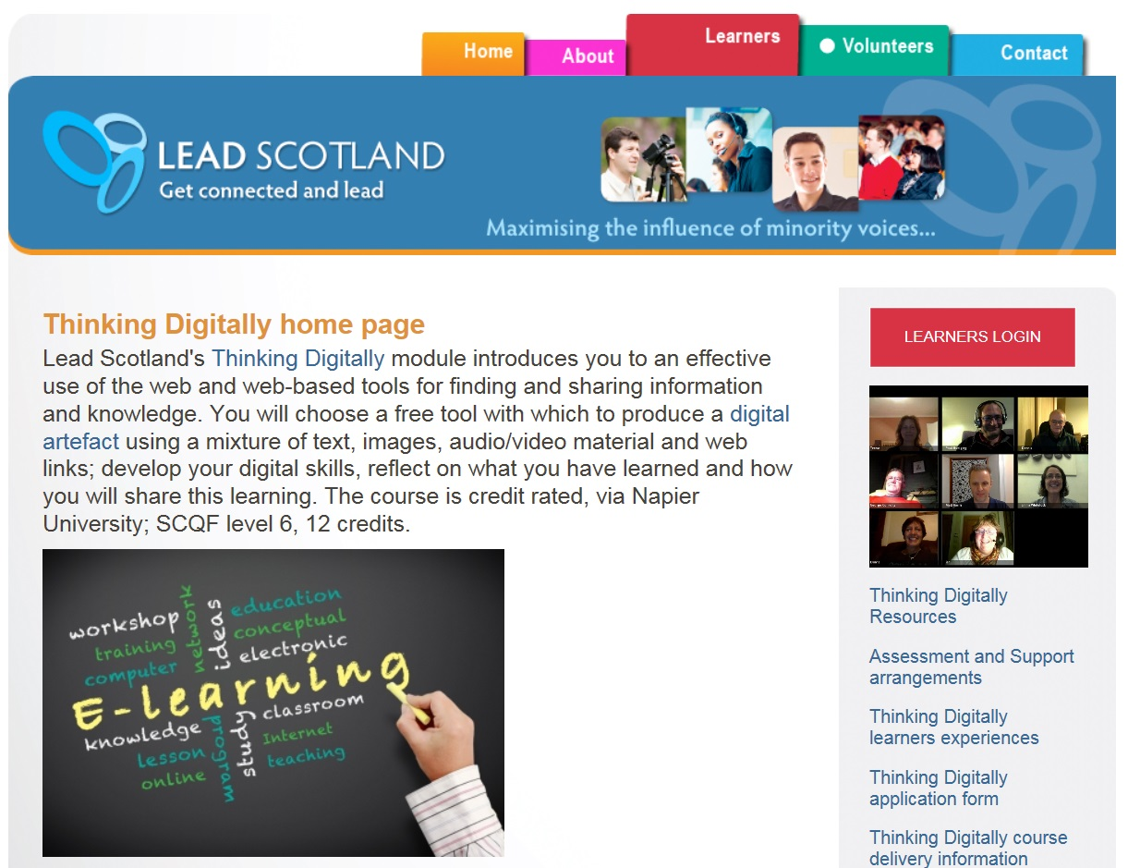
Thinking Digitally at Lead Scotland
http://www.getconnectedandlead.org.uk/show.php?contentid=160

Slide 15
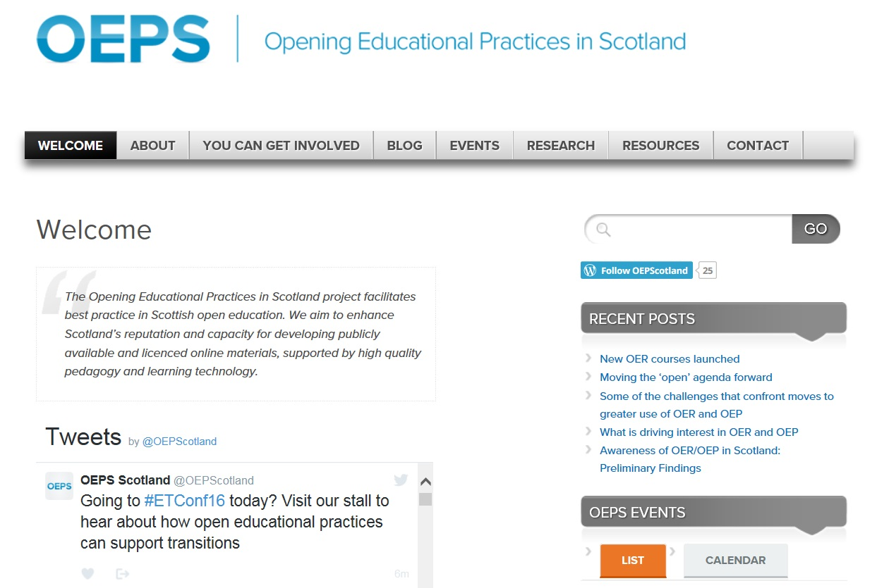
Open Educational Practices in Scotland

Slide 16
Open education and disability

Slide 17
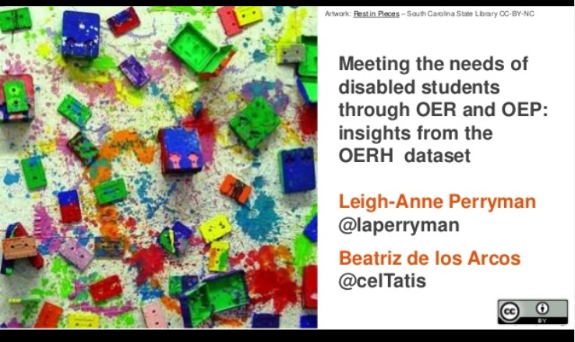
https://artofoer.wordpress.com/2016/04/20/meeting-the-needs-of-disabled-students-through-oer-and-oep-insights-from-the-oerh-dataset/

Slide 18
Where might we go from here?

Slide 19
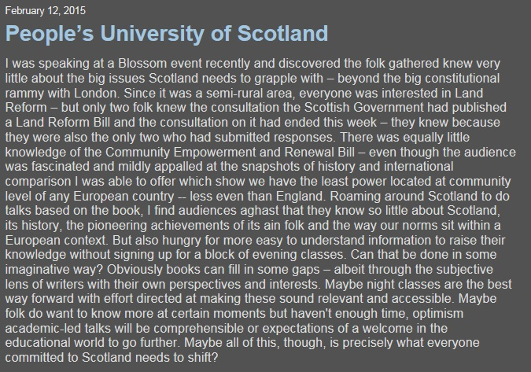
Lelsey Riddoch, 12th Feb 2015
http://www.lesleyriddoch.co.uk/2015/02/peoples-university-of-scotland-.html

Slide 20
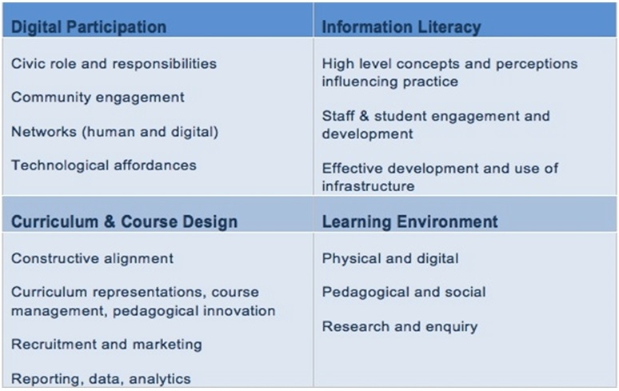
Conceptual matrix for the Digital University
MacNeill and Johnston (2012)

Slide 21
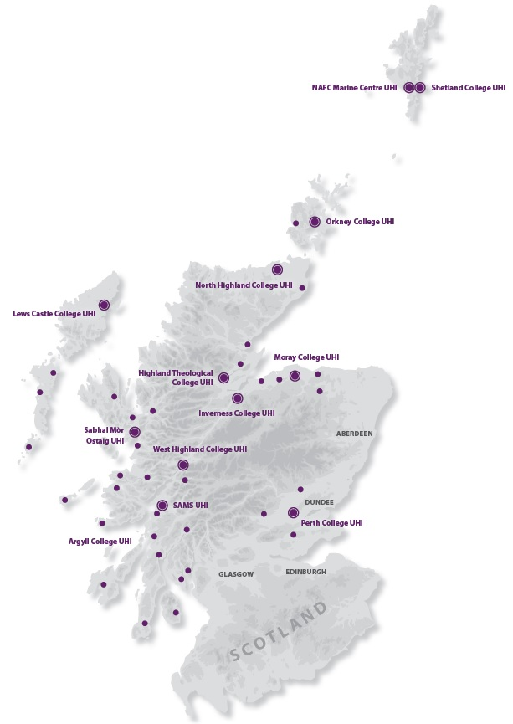


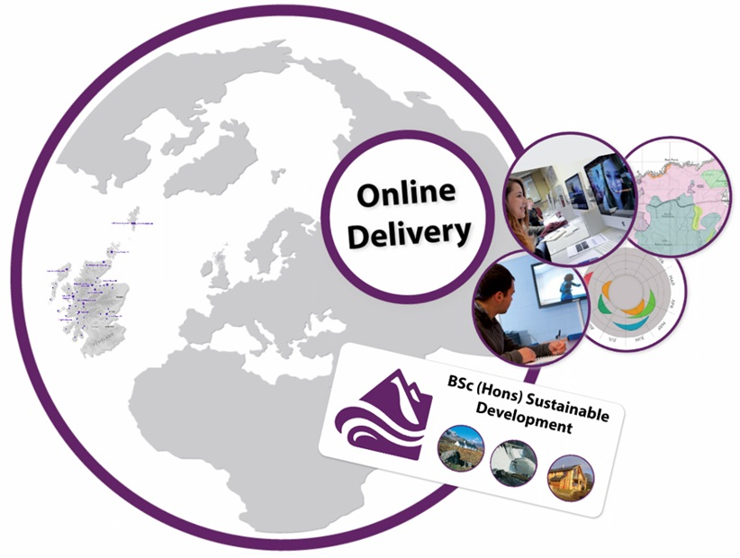
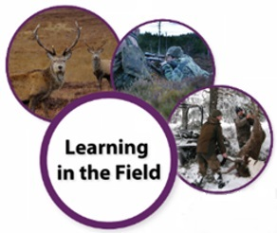

Where digital meets local

Slide 22


Reframing what open education means?
Open UHI?
Bridging informal and formal learning

Slide 23
And an invitation…

