Slide 1

Closing the Gap – Learner Pathways and Transitions
Danni Phoenix-Kane
Jade Justice and
Joseph Maguire

Slide 2
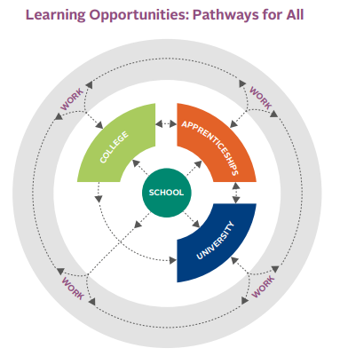
What are Learner Pathways?
A learner’s journey through education and learning
Pathways help map out courses and qualifications to
  develop skills and knowledge
  achieve personal goals
Each learning choice is a step along a pathway
Opens opportunities for new interests and career options/changes

Slide 3
What are Learner Pathways?
Designed to provide personalised, flexible routes through education and into employment
Scotland’s Curriculum for Excellence (CfE) emphasises a broad general education (BGE) followed by a senior phase tailored to individual needs.
Options include academic routes (Highers, Advanced Highers), vocational routes (college courses, apprenticeships), and blended approaches.
Notes:
Where Learning Pathways Take Place:
At school.
At school and college (shared placement).
Through apprenticeships (with college and/or workplace training).
At work.
At university.
Online (SCHLA, Open University, distance learning).
In a combination of the above.
Additional Learning Opportunities:
Local authorities, colleges, and universities offer short courses for learners aged 16+.

Slide 4
What is a Transition? (Positive Destination)
Often refers to the transition from learning (e.g.
  Post-school
  Community Learning and Development (CLD)/Employability Initiatives
Includes:
Higher Education
Further Education
Training
Employment
Voluntary Work
Personal Development Activities
Notes:
Additional Learning Opportunities:
Local authorities, colleges, and universities offer short courses for learners aged 16+.

Slide 5

Education and Disability – Current Outlook
Higher Absenteeism:
Students with additional support needs (including disabilities) are 4x more likely to be severely absent than their peers. (Source: Centre for Social Justice – "Where Have All the Children Gone?")
Positive Destinations After School:
Disabled young people (16–19) in education, training, or employment:
  2018: 86.3% → 2022: 88.7%
  Still lower than non-disabled peers (92.5% in 2022).
Looked-after young people in positive destinations:
  2010: 58% → 2021: 86% (+28 percentage points).
  (Source: Equality and Human Rights Monitor 2023 – "Is Scotland Fairer?")
Notes:
Comprehensive statistics on disengagement rates at different parts of a learner pathway are still limited.

Slide 6

Education and Disability – Current Outlook
Lower Retention Rates:
Students with mental health conditions, Autism Spectrum Disorder (ASD), or multiple impairments face significantly lower retention in higher education. (Source: Scottish Government – "Disabled Students at University" Discussion Paper)
Support Gaps - UK:
Only 77% of disabled students who declare their disability receive a full support plan.
Only 34% have had their support both agreed and fully implemented.
Many students do not declare their disability, further limiting access to support. (Source: Disabled Students UK – 2024 Access Insights Report)
Higher Education
Notes:
Comprehensive statistics on disengagement rates at different parts of a learner pathway are still limited.

Slide 7

Employability and Disability – Current Outlook
Employment Rates (Dec 2022):
Disabled individuals: 50.7% vs. Non-disabled individuals: 82.5%
Employment gap: 31.9 percentage points (higher than the UK average)
(Source: Scottish Government – Labour Market Statistics for Scotland by Disability January to December 2022)
Positive Employability Trend for disabled people:
2014: ~41% employed → 2022: ~51% employed
Faster improvement in Scotland than the rest of the UK
(Source: Scottish Parliament Information Centre (SPICe) – The declining disability employment gap in Scotland: Understanding the reasons behind the increasing number of disabled people in employment)
Notes:
Comprehensive statistics on disengagement rates at different parts of a learner pathway are still limited.

Slide 8
Employability and Disability – Current Outlook
Challenges Remain:
More likely to work part-time & in less secure jobs
Higher risk of underemployment
Disability pay gap persists (lower earnings for disabled workers)
(Source: Scottish Government – Labour Market Statistics for Scotland by Disability January to December 2022)
Notes:
Comprehensive statistics on disengagement rates at different parts of a learner pathway are still limited.

Slide 9
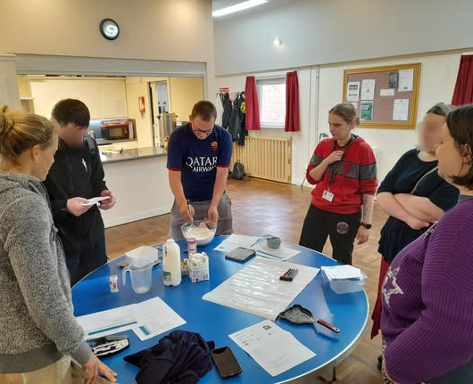
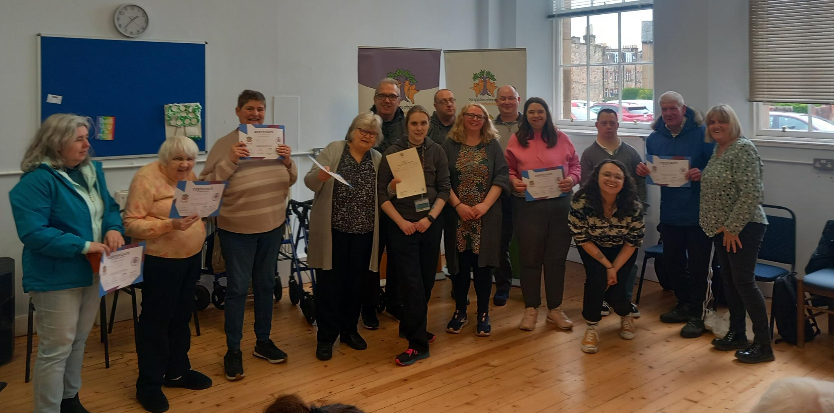
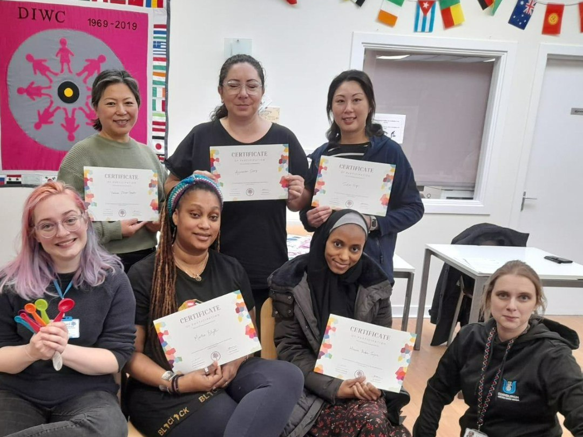

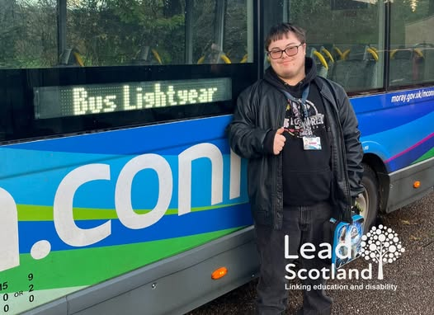
What we do?
Support disabled people and carers (16+) in Scotland to acquire Skills for Life
Removing barriers to learning and promote independence (e.g. home visit provision)
Personalised, one-to one or small group support
Improve access to education and employment
Work with individuals, communities and partners to create inclusive opportunities
“Mobile” Qualifications Centre

Slide 10
Real Impact
Joseph Maguire and Jade Justice
Notes:
Panel discussion.
Questions to ask Joseph:
What made you come to Lead Scotland?
What did you do with us?
What has it enabled you to do now (what positive destinations are you aiming for)?
What things could you not do and can now because of the service?
Questions for Jade:
What was your own learning journey like and how has this informed the work you do with Lead Scotland?
Why do you think services like Lead Scotland are needed?
What do you think may be the future if services like ours continue?

