Slide 1

Digital inclusion, cyber resilience and fair access
Emma Whitelock
Michael Chamberlain-Cove

Slide 2



What does our Cyber project do?
Accessible resources
Formal and non-formal learning
Partnership working
Notes:
Our cyber accessibility project covers six key areas, of which we’re going to look at three – providing accessible resources, delivering tutoring supported training
creating a bridge between expert knowledge and disabled people
You might be wondering why this matters – what need is there for this project across Scotland?
25% of people with a disability or health condition lack Foundation Essential Digital Skills (CDI)
What We Know About Digital Inclusion | Good Things Foundation
Cyber crime on rise
Won Digital Difference at Scottish Charity Awards, a clear sign that this is working
Linking silos of cyber resilience, online harms, and wider access
This is not one-off work – this empowers people to take the first steps to develop their skills and knowledge. And they can carry on developing those skills and knowledge

Slide 3
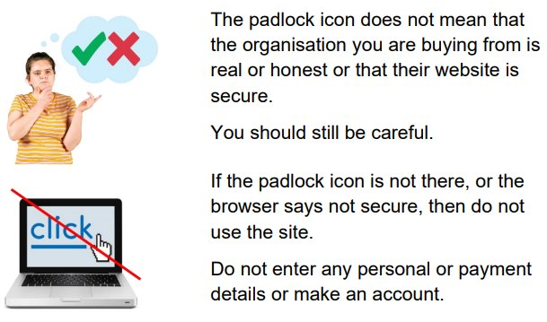
Accessible resources
Easy Read
BSL (British Sign Language)
8 community languages, including Polish, Mandarin, and Ukrainian
Notes:
Our cyber project is all about developing skills and confidence in our learners. We know that the typical way of delivering information on cyber security – long, boring, and technical blog posts, documents and press releases – is not accessible for many people. Throughout the project we look at ways we can make this more accessible, and one of the ways we do this is through getting guidance from trusted sources, such as the NCSC, Police Scotland, and Take Five to Stop Fraud, and getting these turned into accessible formats, bridging the gap between expert knowledge and disabled people.
At present, we have 20 guides in Easy Read,16 BSL clips, and text and audio guides in 8 community languages. We have demand for more guides on every format, for our community language guides, we had demand for 36 different languages.
Now, if you are not familiar with these formats you might not know why we go through the effort of translating resources into Easy Read and BSL clips.
EXPLAINER

Slide 4
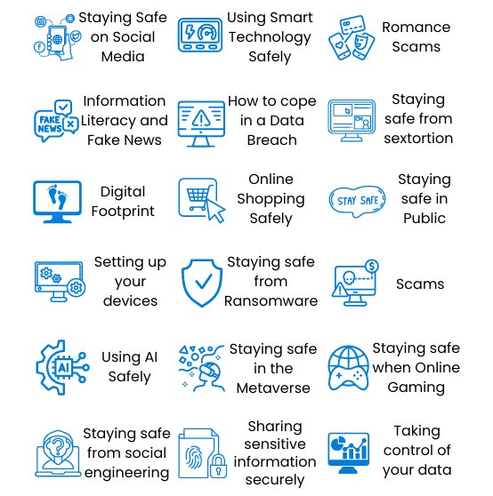
Formal and non-formal learning
Designed to build confidence, skills and knowledge
Since 2020, we have had over 1500 people develop their skills and knowledge
Notes:
Providing accessible resources is an excellent first step to helping build skills and confidence. But we also run tutor supported training sessions for members of the public.
We run the courses on a huge range of different topics, from the 6 key actions we need to take to secure our accounts, to deeper dives on specific fraud, like romance scams. These sessions are a great place for people to come along and learn something new, with every step they take being step away from becoming the victim of a cyber crime.
We also run tutor supported webinars. These are friendly online spaces for members of the public to come along and learn about different aspects of staying safe online. We try and make these sessions as accessible as possible from the outset, but we also are happy to support individuals with additional support needs to attend, for example, we have run sessions with BSL interpretation for an audience member who requested them. ​
​
These sessions have plenty of time for Q&A, so that people can ask the questions that are relevant to their own situations. ​
​
Each tutor supported webinar has a corresponding course on our online learning platform, where you can review the content at your leisure, and also access free resources (such as our Easy Read guides).
We are actually in the middle of Cyber Scotland Week 2025, so we have some tutor led training sessions running this week and next, and it’s well worth checking out the upcoming webinars page of our website if you are interested.
​
Alongside these public sessions, we also run tutor supported training the trainers sessions for organisations. Over the last five years, we’ve noted that people who work in roles providing support and care to disabled people are increasingly becoming relied on to give advice on staying safe online. This is leading to a lottery of digital support for disabled people. We are working to redress this by providing training to local authorities and third sector organisations, helping develop skills and confidence to effectively support disabled people.
Across this year, we have spoken to over 220 people at our public sessions, and have had an indirect reach to over 370 people on top of this.
Alongside all of this we provide formal learning opportunities – we run a SCQF level 4 joint award in Cyber Security Fundamentals and Internet Safety. This joint award is designed to cover everything you need to know ot keep yourself safe online, and we have delivered this to 14 disabled people, with more groups starting this week. This qualification has been transformative, with one learner, who was long-term unemployed, using the confidence from this course to apply for and get their “dream job” in local government.

Slide 5
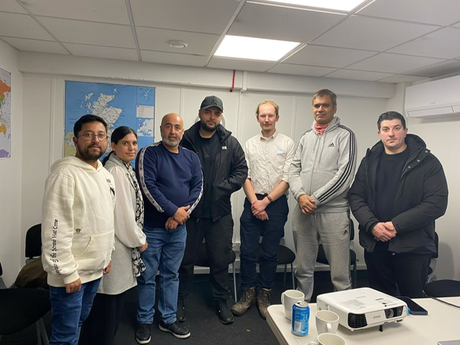
Case study
Deaf people have been at risk of becoming the victim of scams
We worked with Scotland’s Ethnic Minority Deaf Charity to create resources based on their members’ needs
We delivered in person training
We will deliver formal training to create community knowledge
Notes:
In one of our advisory group sessions, one of our contacts with Police Scotland mentioned that they were aware that Deaf people were being scammed. They asked us to link up with one of their sergeants, who was trying to reach members of the Deaf community.
We reached out to partner organisations, and spoke to Scotland’s Ethnic Deaf Minority Community, a charity that works with people that speak a different sign language as their first language, and have had to learn BSL as a second, third, or fourth language. SEMDC’s service users can thus find written English very inaccessible.
We organised an in person session with their service users to go over the some of the most important points raised by the National Cyber Security Centre. This involved me travelling down to Glasgow from the North Highlands.
The reception with SEMDC was fantastic – their service users were extremely motivated to learn about cyber resilience, as they had struggled to access information on this before. Many of them had been the victim of a scam, or had a family member who had been.
The result of this was that everyone who attended – including the interpreters – left with more knowledge and confidence around staying safe online.
Not only this, but we will be running further sessions to upskill and empower their members, and we will also be delivering our formal qualification at SCQF level 4 to two of their members, so that they can act as trusted sources of knowledge in the community, cascading this important information on, helping to reach further into this community
INSERT PIC FROM SEMDC

Slide 6
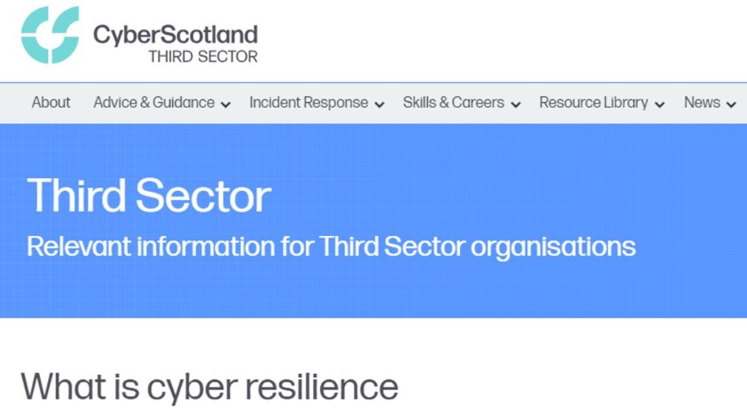
Partnership Working
Notes:
It’s not enough for us to just provide resources and upskill members of the public, we also work with organisations to develop their content and strategies, advocating for ensuring disabled people are considered and included.
Blogs for Fearless
Blog for Youthlink Scotland

Slide 7

“Just wanted to let you know that after our chat, I was so inspired by the work that you do that I’ve commissioned a BSL video for the campaign to be created and plan to do so for other future projects too, alongside Easy Read”.​
Notes:
This is some feedback we received from an organisation we worked with, showing how the work we’re doing is creating positive impacts across the sector.

Slide 8
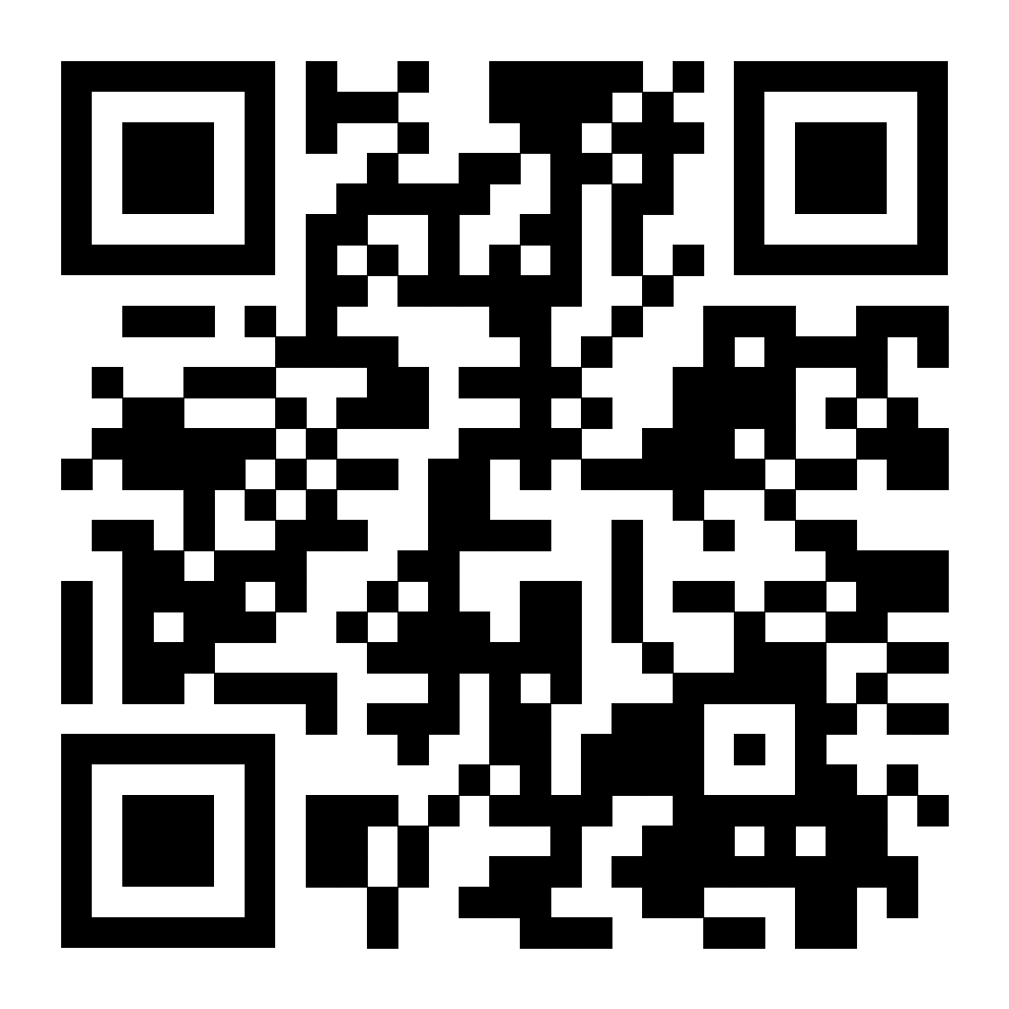
Help us widen access and improve transitions
Book
A place on a Cyber Scotland Week webinar
A workplace session to upskill your organisation
Share
Our accessible resources
Our online learning platform

